Slide 1
TRIMIT 2013 until latest Release of TRIMIT
What’s new/changed in

Slide 2
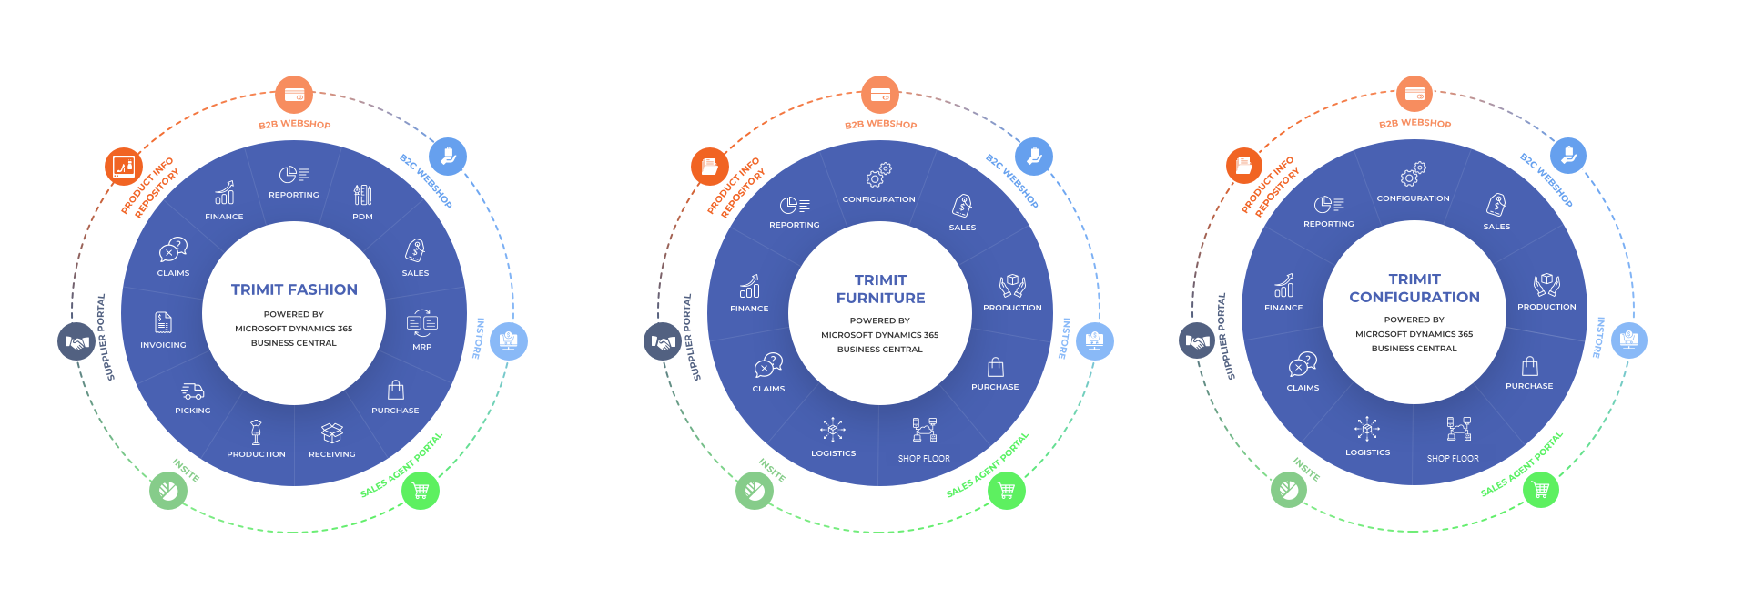
TRIMIT End-to-end solution
On-premise, in the cloud, anywhere, any device.

Slide 3
New/Changed in
TRIMIT 2013

Slide 4
TRIMIT 2013 ERP – November 2012
Improved RoleTailored User Experience
Special TRIMIT Role Centers
Tree View of Item Bill of Materials
NAV Budgets in TRIMIT Sales Statistics
TRIMIT Native Reports converted to Report Services
RapidStart Services, special TRIMIT Package
Matrix Distribution

Slide 5
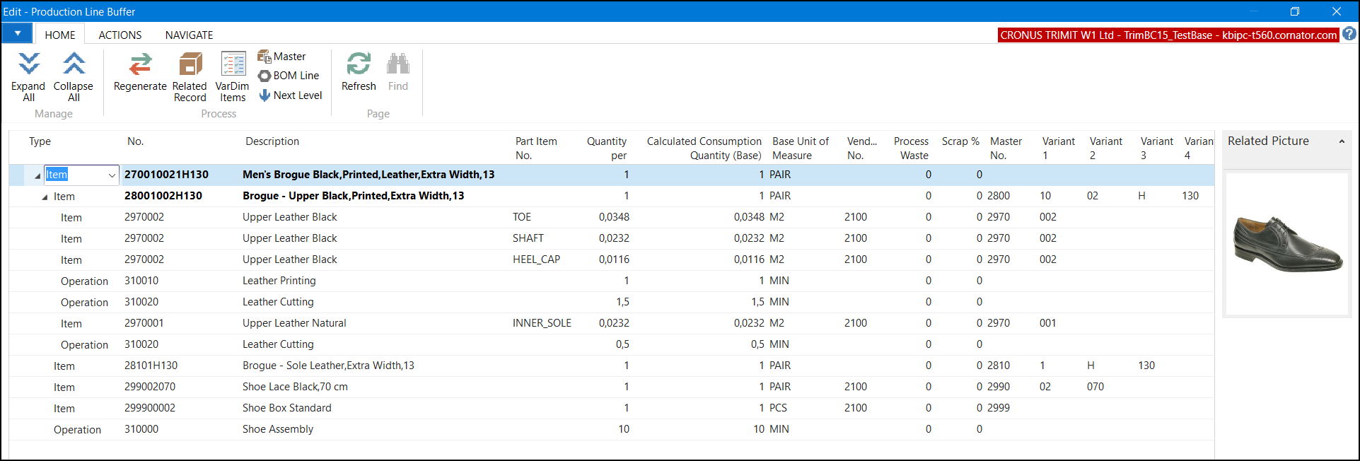
Tree view of Item Bill of Materials 2013

Slide 6
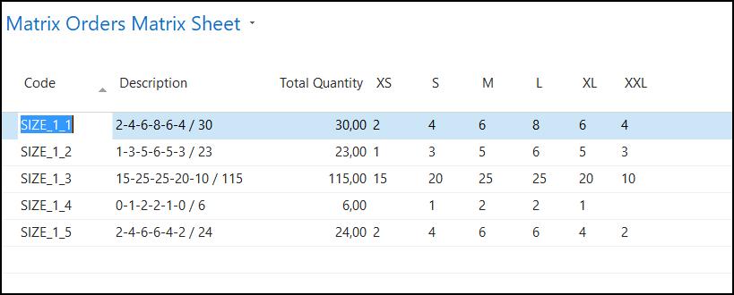
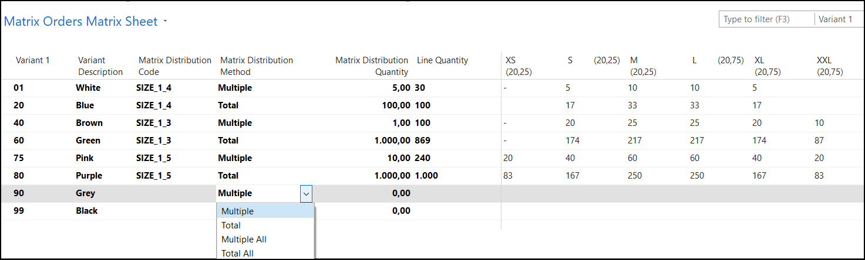
Matrix Distribution 2013

Slide 7
New/Changed in
TRIMIT 2013 SP1

Slide 8
TRIMIT 2013SP1 ERP – August 2013
Improvements Collection Management and Shipment Date Code Handling
“We needed the SP1 package of NAV”

Slide 9
New/Changed in
TRIMIT 2013 R2

Slide 10
TRIMIT 2013R2 – December 2013
Completely redesigned Datacapture
Matrices have Totals per Line
On-Line Help via web

Slide 11
TRIMIT 2013R2 Portals – December 2013
This release of the TRIMIT Portals includes Bootstrap and a list of themes for the appearance. All the Portals have been re-engineered to comply with multiplatform scaling. This means that the layout automatically changes depending on the screen size.
Supplier Portal framework

Slide 12
New/Changed in
TRIMIT 2013 R2S

Slide 13
TRIMIT 2013R2S ERP – May 2014
Integration to NAV WMS
Improvements on Calculations
PDM Report Set

Slide 14
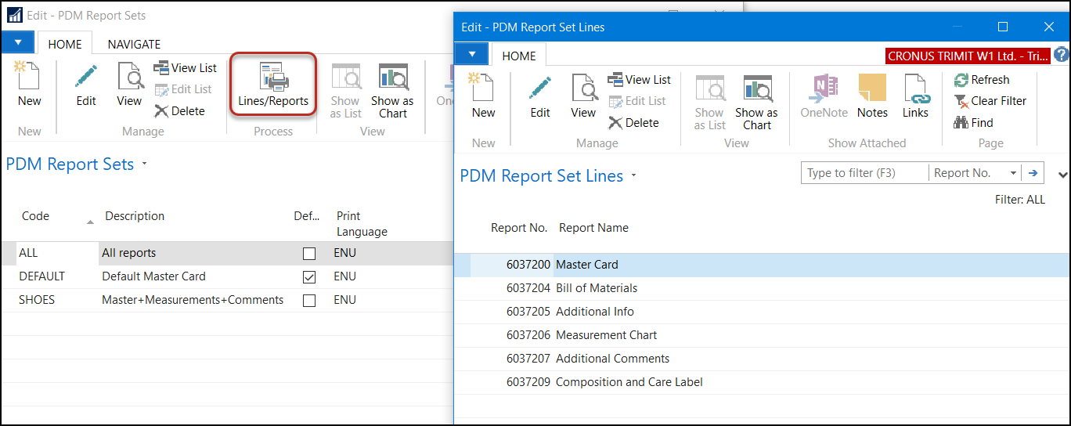
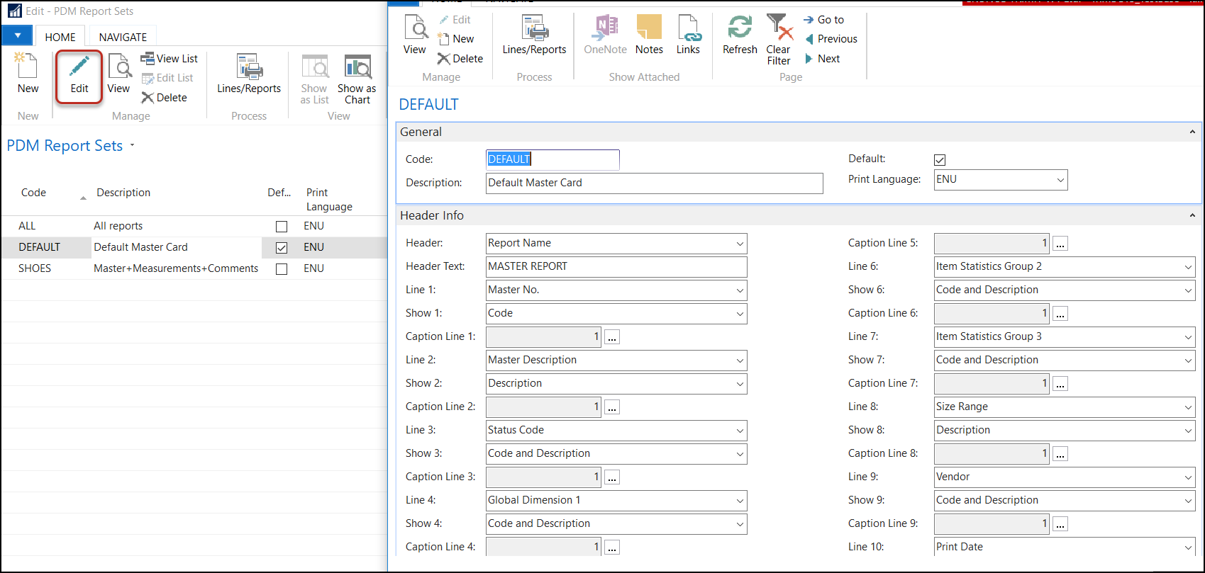
PDM Report Set 2013R2S
Set of several PDM Reports, that can be printed, reviewed, created as ONE big pdf-file
Select the reports you want to have
Determine the 10 fields in the top of the reports

Slide 15
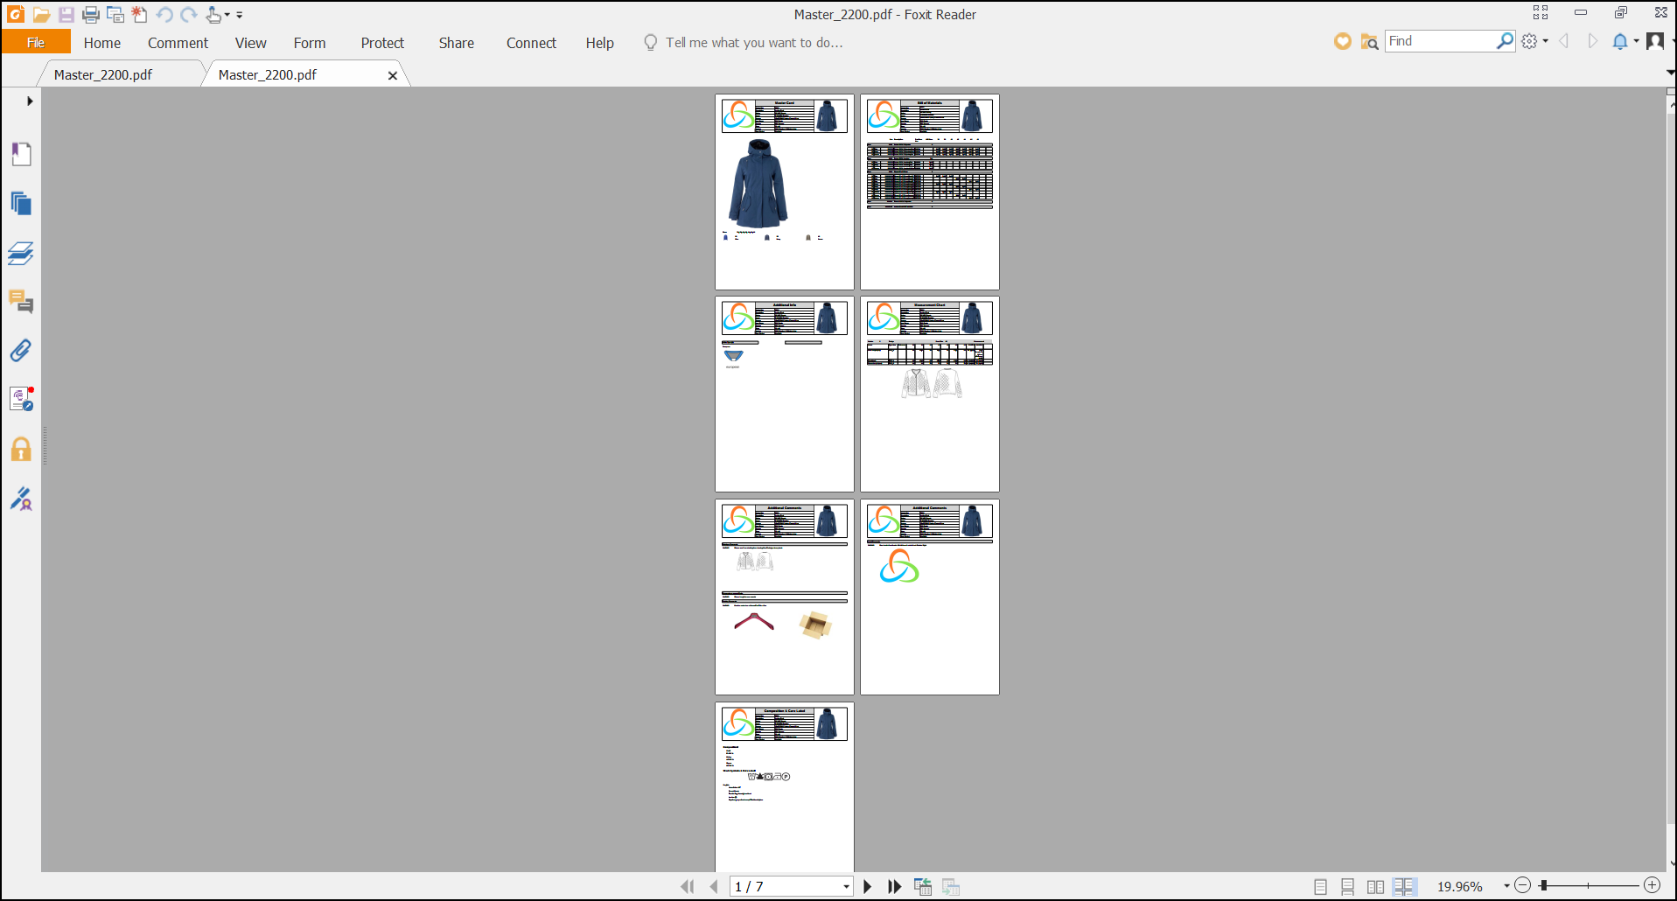
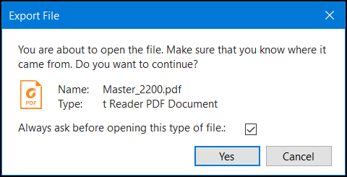
PDM Report Set 2013R2S

Slide 16
TRIMIT 2013R2S Portals – May 2014
B2C Framework
On all portals, the multi device layout is complete. The user experience will follow you on whatever device you choose for the task. On the B2B and Sales Agent, we now introduce “Load on demand” on the edit order page.
Advanced Sales Integration
No Lost Orders
Multiple Availability Check Methods

Slide 17
New/Changed in
TRIMIT 2015 on NAV 2015

Slide 18
TRIMIT 2015 ERP – November 2014
TRIMIT Workflow on many Cards/Documents including Workflow Templates
  Filtering Workflow Due List improved
  Steps can be approved or rejected
Production Order Archive
Measurement Chart improved: copy values
Master Variant Overview
Improvements in setting up formulas
Availability Check on Demand and on Location Filters
Mandatory Order Types Yes/No in Sales & Receivables Setup and in the Purchase & Payables setup
Default Line Types for Sales/Purchase Documents
Purchase Order Overview
Upgrade from 2013R2S => 2015 but also upgrade tool from 605 => 2015

Slide 19
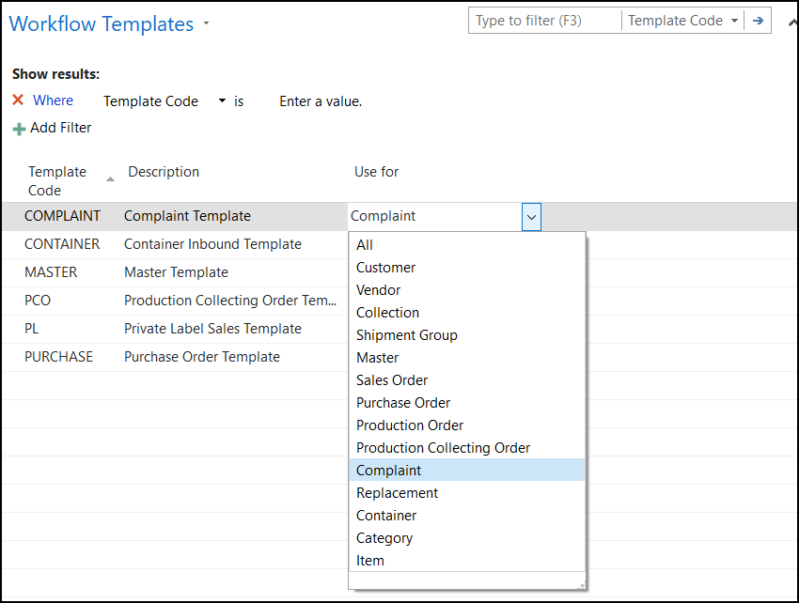
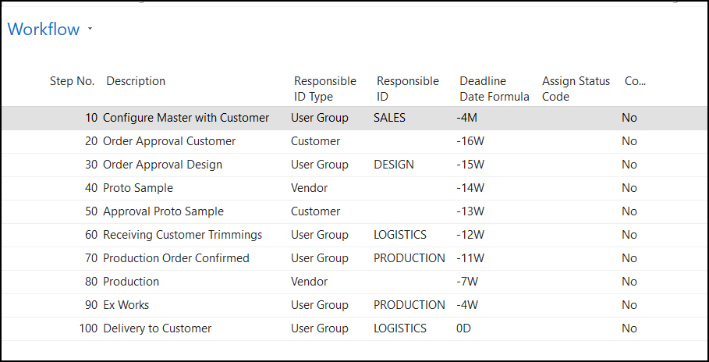
TRIMIT Workflow 2015
Available for many documents not only on the Master including specific Templates that can be used.
I.e. for Sales Orders

Slide 20
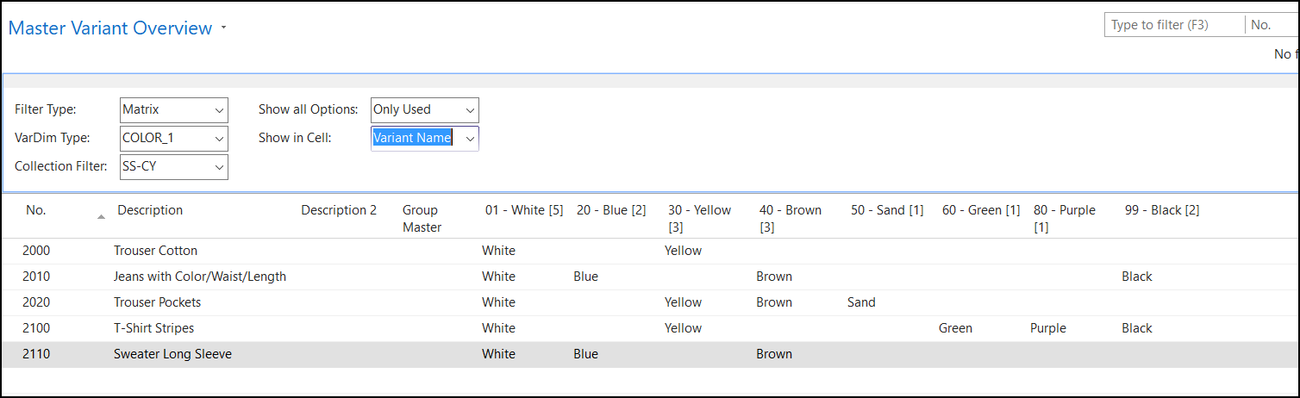
Master Variant Overview 2015

Slide 21
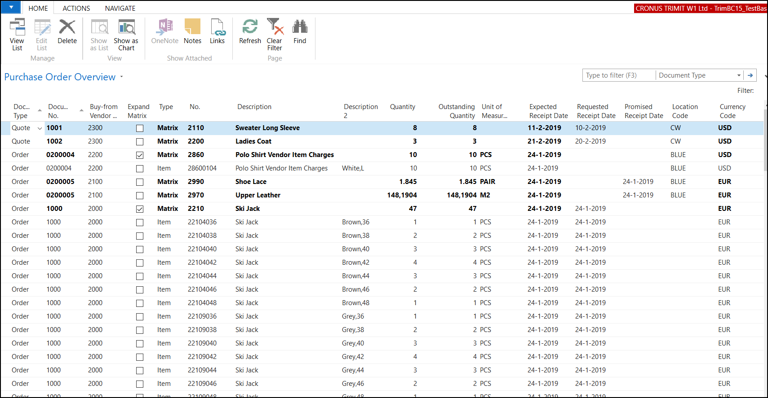
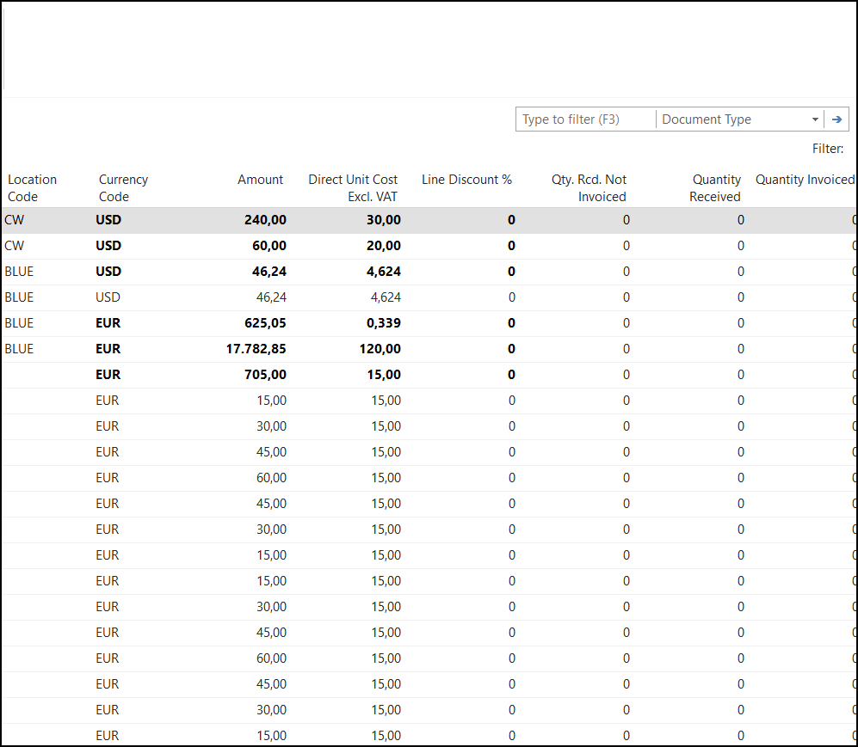
Purchase Order Overview 2015

Slide 22
TRIMIT 2015 Portals – November 2014
B2C
  Shop the Look
  Store Locator
  Gift Cards
  Customer Club
  Item Reservation
  B2C Schedules
  Look Book
  E-Mail Queue
  Soft Admin

Slide 23
New/Changed in
TRIMIT 2016 on NAV 2016

Slide 24
TRIMIT 2016 ERP – January 2016
Simplified Menus (Menu 1051)
Master Matrix Analysis based on profiles
Inventory Profile Report
New Add-Info, Composition, Care Label
CRM Role Center
Page Action Globally
Outsourced Production / Transfers Inbound and Outbound
Translation on Item Groups
Improved Collection Management / Delivery Periods
Improved Blanket Order Search
E-Mail solution with templates for creating the mails including text for body of the mail
PDM reports improved
FIFO and Average Costing Method – also for TRIMIT Production
Tasklet Factory objects as part of Standard
Demo Sites for prospects including ERP, B2C, B2B, Sales Agent, Supplier Portal, Web Client, Windows Client
Upgrade from 2015 => 2016 but also upgrade tool from 605 => 2016

Slide 25
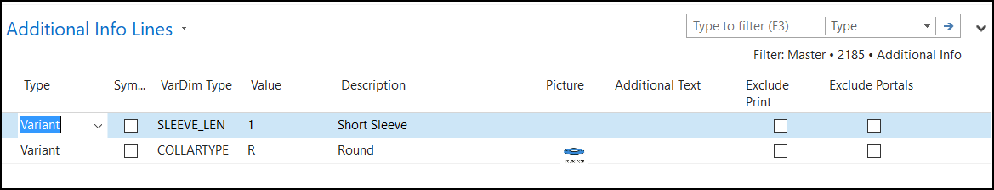
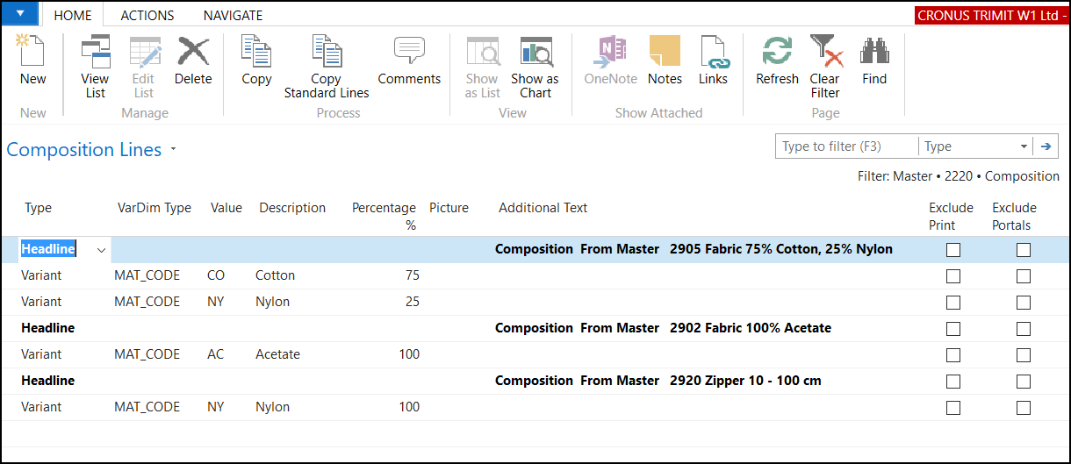
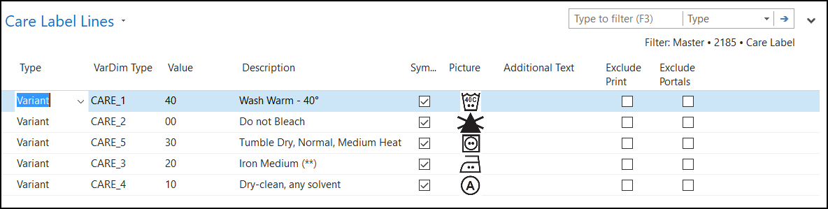
Add-Info, Composition, Care Labels 2016

Slide 26
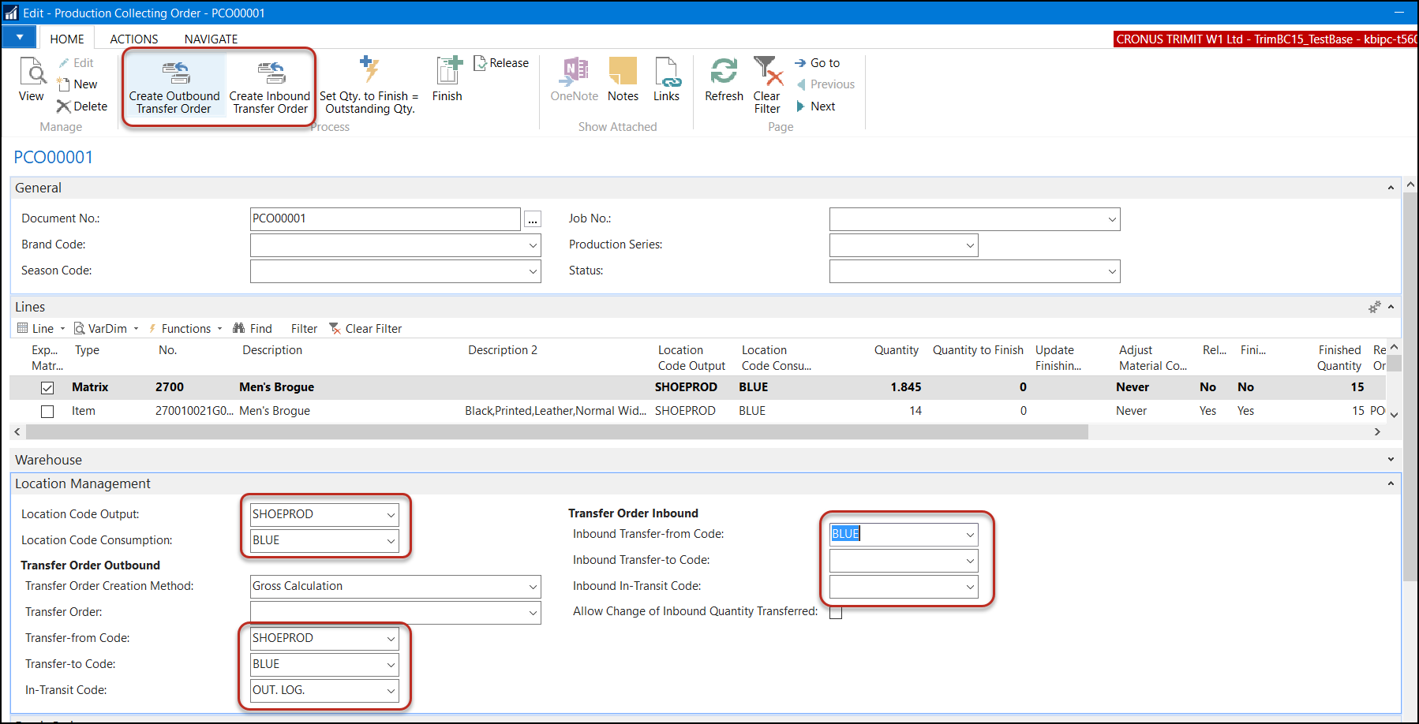
Outsourced Production and Transfer Orders 2016

Slide 27
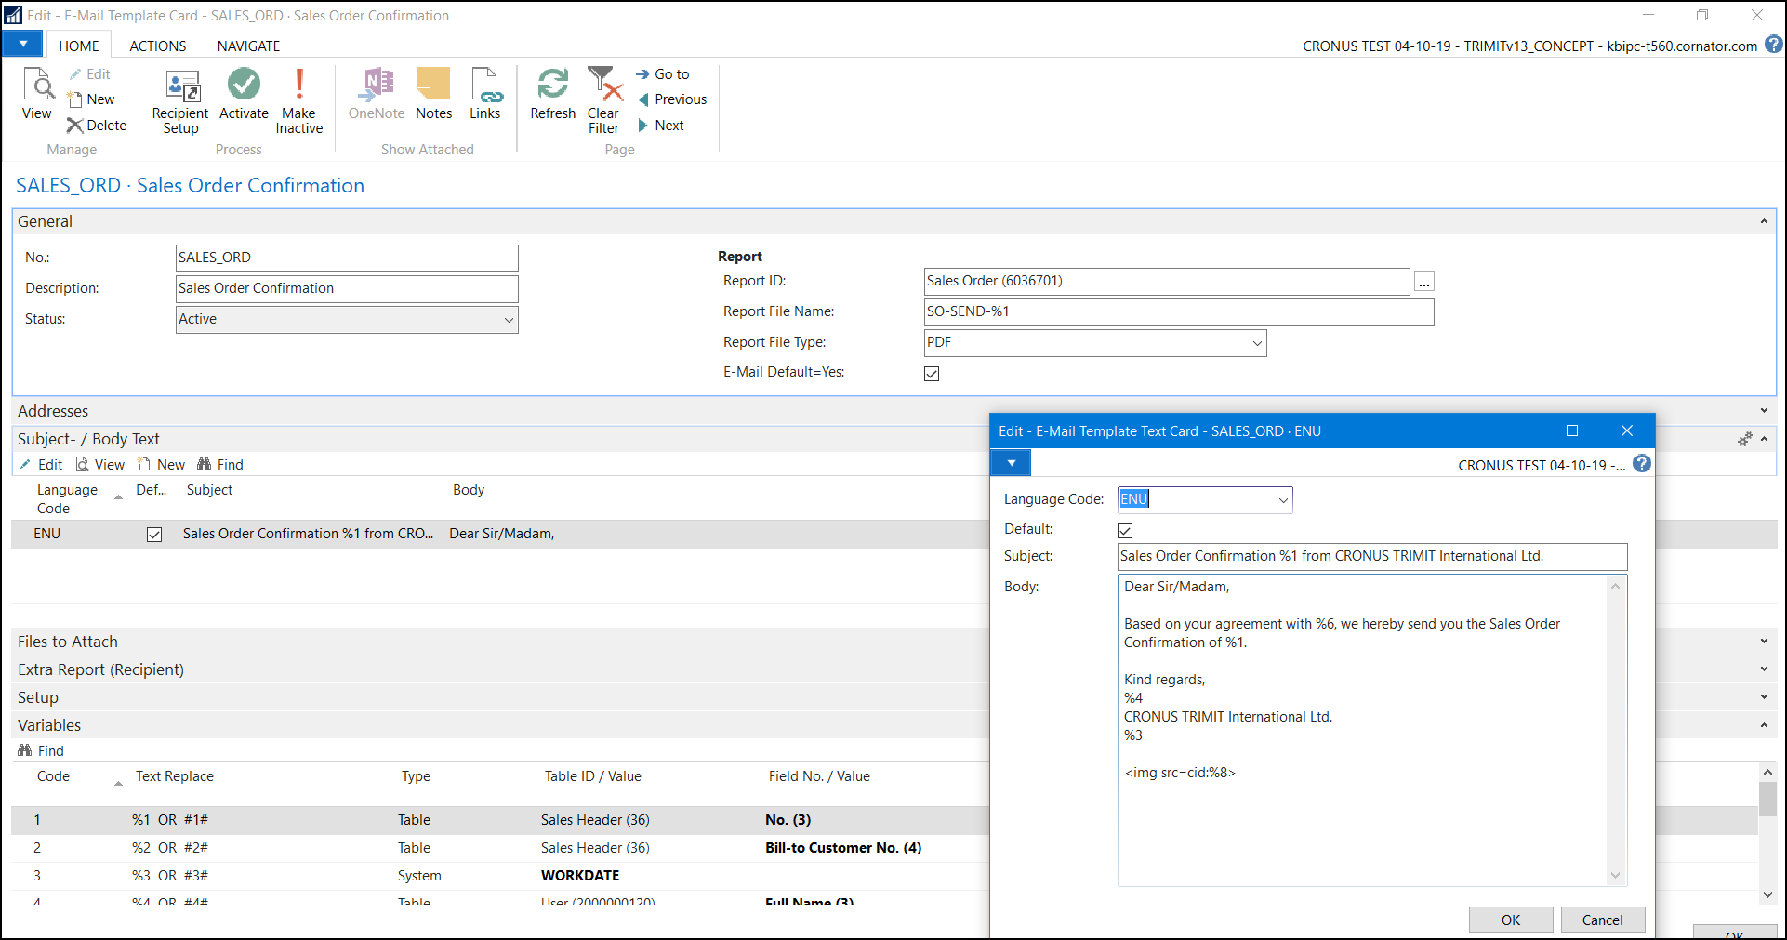
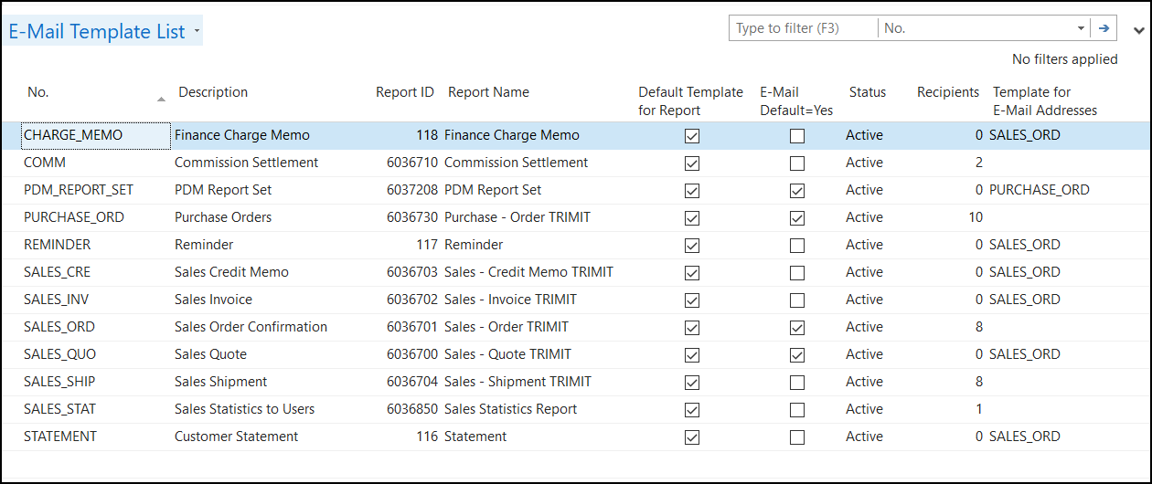
E-Mail Functionality 2016

Slide 28
TRIMIT 2016 Portals – January 2016
Fast Save
Copy Orders
Order Template
Select Order Type incl. Pictures (+ mandatory)
Dash Boards on SA, B2B & SUP
Delivery Period
Get Direction to a Customer on SA
Delivery Address on B2B
Promoted Item in B2B
Including ASI in Availability Check
Extended Text
Composition & Care Label
Price differentiation on matrix cells
Shopping Gift Card in B2C

Slide 29
New/Changed in
TRIMIT 2017 on NAV 2017

Slide 30
TRIMIT 2017 ERP –Dec 2016
GUI/UX Improvements
  Renaming of fields (aligned with NAV)
  Images for functions on ribbons
  C/AL code has been cleaned-up
Customer Service Role Center
Improvements in E-Mail functionality
Item- and SKU Maintenance via the Master
Improved Replacements
PDM Report Set also save to disk
Measurement including “Compare with”
Transfer Orders based on Sales Orders via MRP Calculations
Transfer Order included in MRP Calculation
Copy BOM Lines functionality extended and default values for next level
Selecting Purchase Price for updating Last Direct Cost/Calculated Unit Cost
Search Tags deleted ➔ NAV Item Attributes
Search Table Lines with extra function to Maintain easily
TRIMIT Item Charge also available for FIFO
Bin Code in TRIMIT Pick Documents
Copy Master by Wizard now includes a Setup
Separate Menu’s for Inventory (FIFO costing) and Inventory – Standard Costing
And many smaller changes/additions

Slide 31
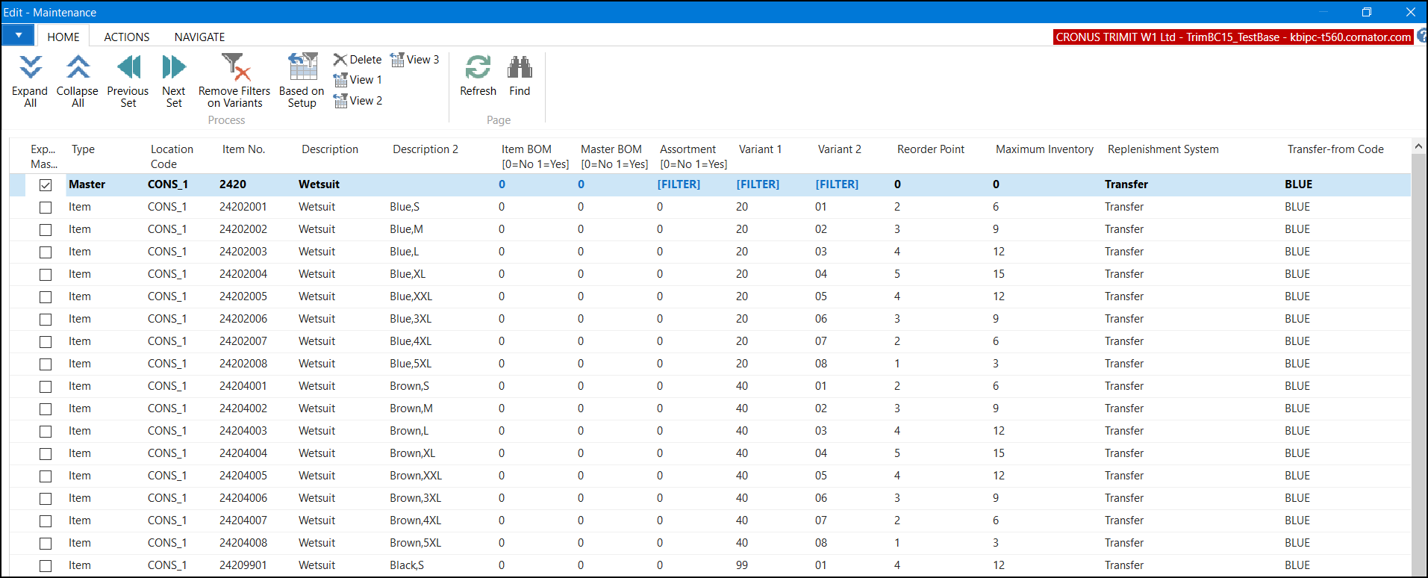
Item and SKU Maintenance 2017

Slide 32
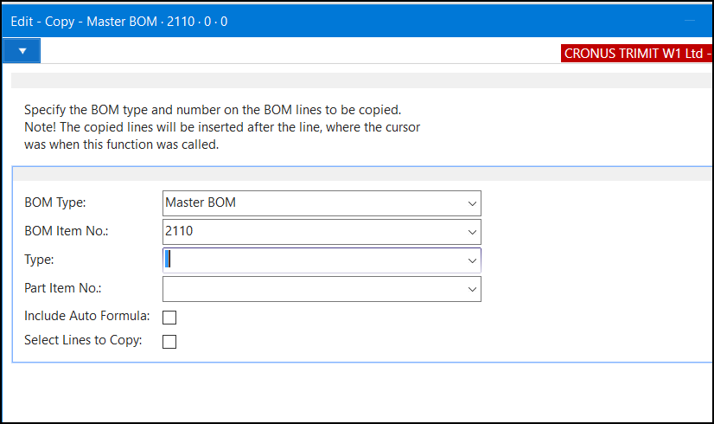
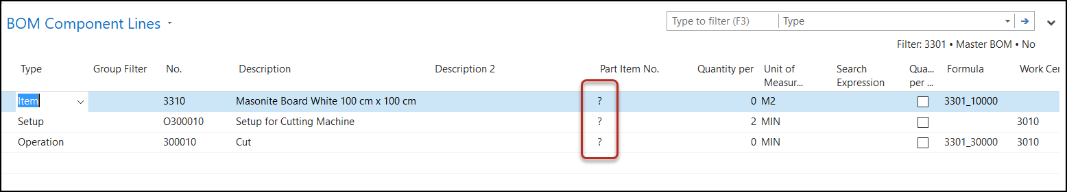
Copy BOM Lines functionality extended and default values for next level 2017

Slide 33
TRIMIT 2017 Portals –Dec 2016
Product Information Repository (PIR)
InStore B2C
Where to Buy in B2C
Portal Payments in B2B
Availability Indicator in Matrix Cells
E-Mails via TRIMIT E-Mail functionality

Slide 34
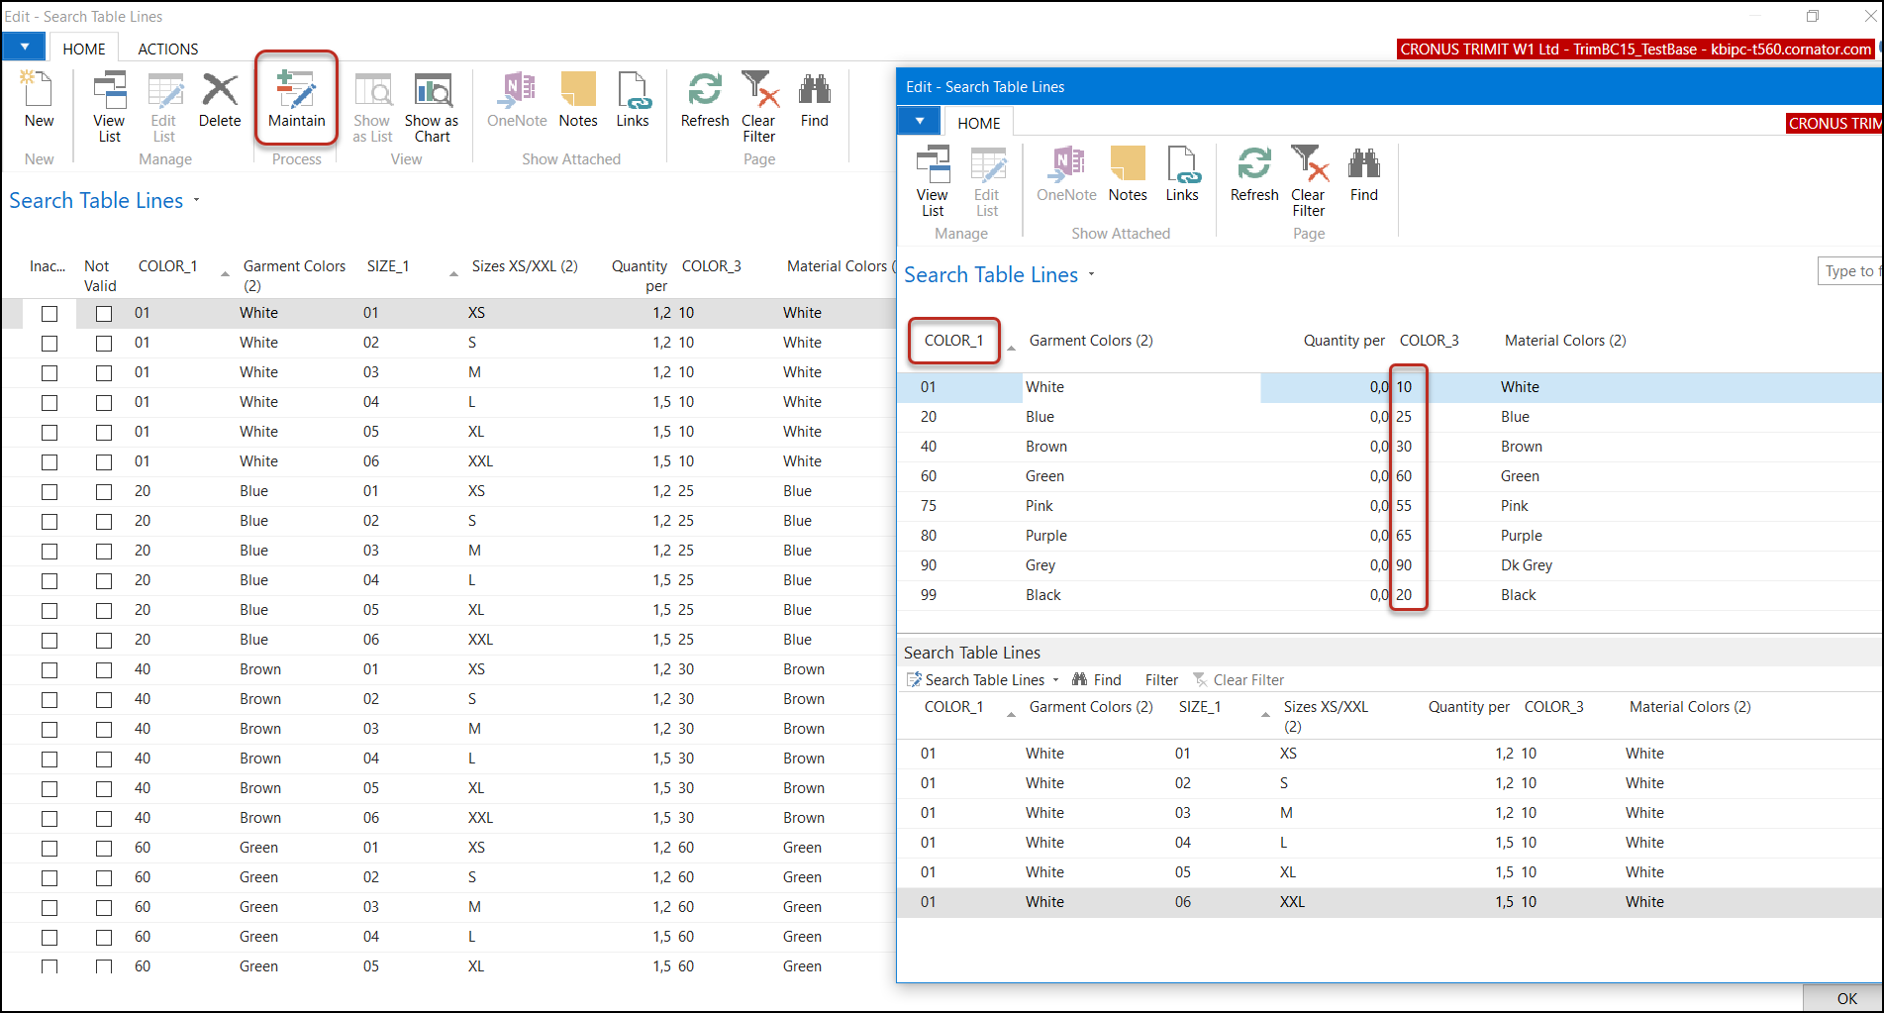
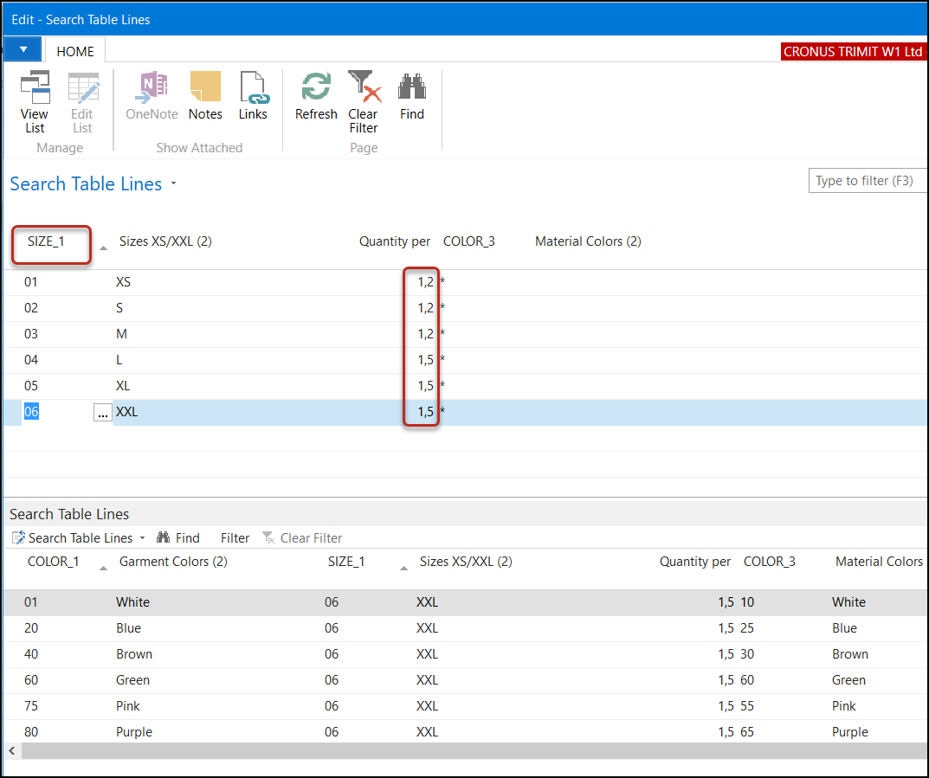
Search Table Lines – Maintain 2017

Slide 35
New/Changed in
TRIMIT 2018 on NAV 2018

Slide 36
TRIMIT 2018 ERP – Feb 2018
Group Filter on BOM Component Lines to filter on Items
Extended functionality for “Where-Used”
Improved E-Mail functionality (also for reports 116 Statement and 117 Reminder) and usage of several E-Mail Addresses divided by a semicolon
Improved/Extended Intercompany functionality; Creating Pick Documents in HQ for Sales Orders subsidiary
Replication for replicating data from one company to another (including Masters)
Improved/Extended Item Replacement; more filters and possibility to change Shipment Dates or Location for many Sales Lines at once
MRP: calculation buffer, batch log and special Job Queue
PDM Information on Item List/Card
Sales Bank Account Setup
New field for Sales Channel (Order Type, Sales Orders)
And many smaller changes/additions

Slide 37
Bill of Materials – Group Filter 2018
New field Group Filter on the BOM Component Lines to limit the lookup for No.
Group Filter can be defined as a filter on Items, Operations, Setup and Sub-Supplier – the Type of the BOM Component Lines.
Easy to setup as normal filters on an Item List or Operations List.
You can take Type out of the BOM Component Lines; this is then already set by the Group Filter.

Slide 38
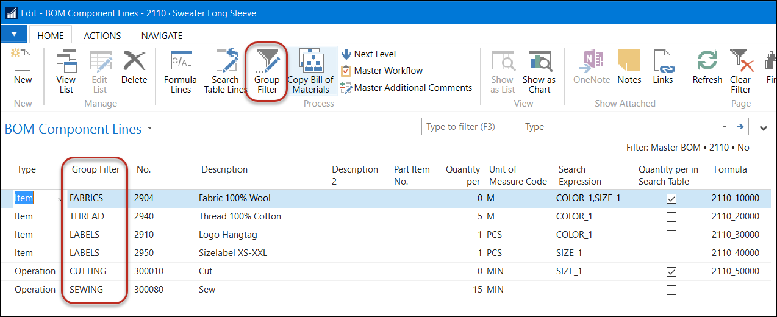
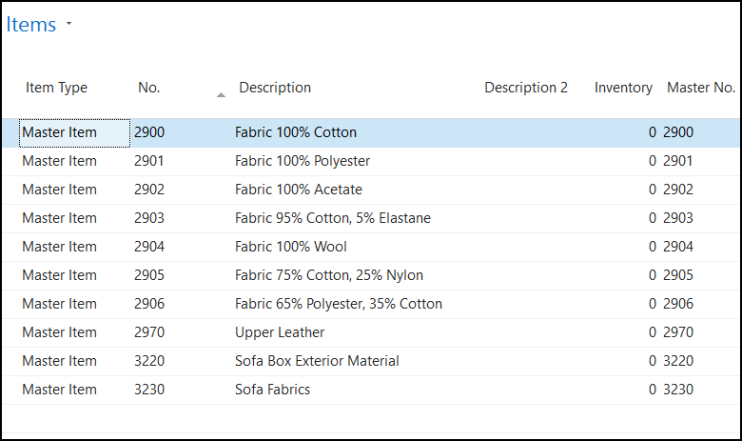
Bill of Materials – Group Filter 2018
Notes:
In a Bill of Materials you will be able to filter on specific Items, Operations or Setups. This makes choosing the right Item or Operation much easier.
I.e. a Group Filter FABRICS will only show Master Items that are Fabrics.
Clicking Group Filter on the ribbon will show you the actual filter of the Group Filter

Slide 39
Where-Used 2018
Extended functionality for Where-Used
  In which BOMs is a Master used
  In which BOMs are Items of a Master used
  In which BOMs is an Operation used
Added action for Where-Used on basic information
  Master List/Card
  Item List/Card
  BOM Component Lines
Added action for Where-Used on document lines
  Purchase Document Lines
  Production Order Lines
Report for Where-Used

Slide 40
Where-Used 2018
Three types of Where-Used
  BOM Information: This will explode all the BOMs of Masters, and show you in which Masters the requested Master is in the BOM Component Lines.
  Item and BOM Information: This will explode all the BOMs of Masters, and show you in which Items, the Items of the requested Master are used in the BOM Component Lines.
  Master and BOM Information: This will show the Masters in which the requested Master is in the BOM Component Lines. Therefore, it will only search in the BOM Component Lines.

Slide 41
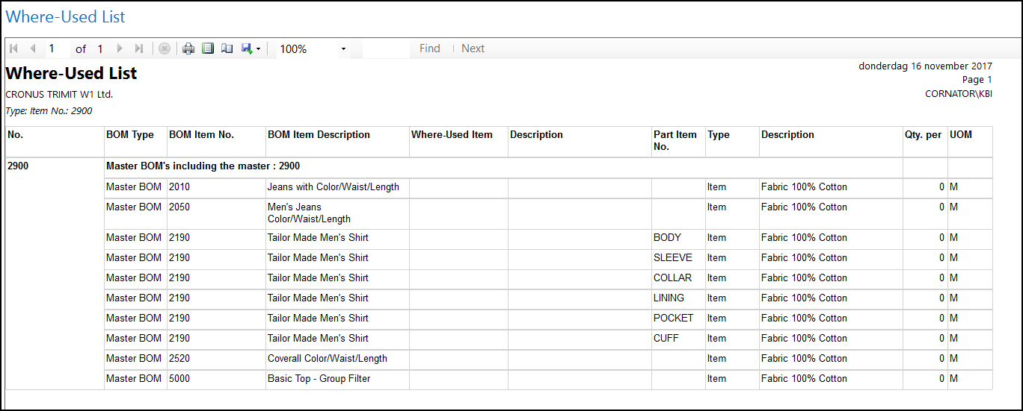
Where-Used Report 2018

Slide 42
E-Mail Functionality 2018
In all E-Mail Address fields of a Template and its Recipients, you are now able to add several E-Mail Addresses divided by a semicolon – as you can do in normal E-Mails
  I.e. kbi@trimit.com; trr@trimit.com
Variable with Type Manual: i.e. a text or decimal
In the Recipients Card the Lookup for the Contacts will now offer you a choice for the Lookup:
  Should the Lookup show you All contacts or only the Limit Recipient Company (Contacts of the current Recipient No.)
Closing page of preview E-Mail (with Esc or OK button) will give you a message if you don’t want to Send it.
Added E-Mail C/AL Code to reports 116 Statement, 117 Reminder and 118 Finance Charge Memo

Slide 43
Intercompany 2018
Technical improvements
  Functions rewritten for using TRIMIT Services and normal Related Orders functionality
  Not a Document Type anymore, but a Boolean
  Not an Entry Type in Item/Value Entries, but a Boolean
Functional improvements
  Matrices in Intercompany Sales-/Purchase Orders
  You can now also use WMS functionality for Intercompany Orders
  Create Pick Documents in Head Office for Orders from Sales Office
  Changing Sales Order in Sales Office can change Pick Documents in Head Office if Status is blank
  Goods can be picked from several bins for one Pick Document Line
  Create Intercompany Purchase Orders based on Posted Intercompany Pick Documents in Sales Office

Slide 44
Replication 2018
New functionality to copy information from one company to another company in one database.
Replication set for Items/Masters can be created with an action – this includes all related tables as well
Parameters available to be changed automatically during replication process – specifically for replicating Items/Masters
After an initial replication you can use action replicate which will only replicate the changed/added/deleted records from the Publisher to the Subscriber

Slide 45
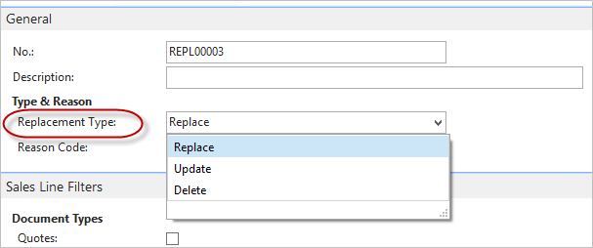
Item Sales Replacement 2018
  Replacement Type

Slide 46
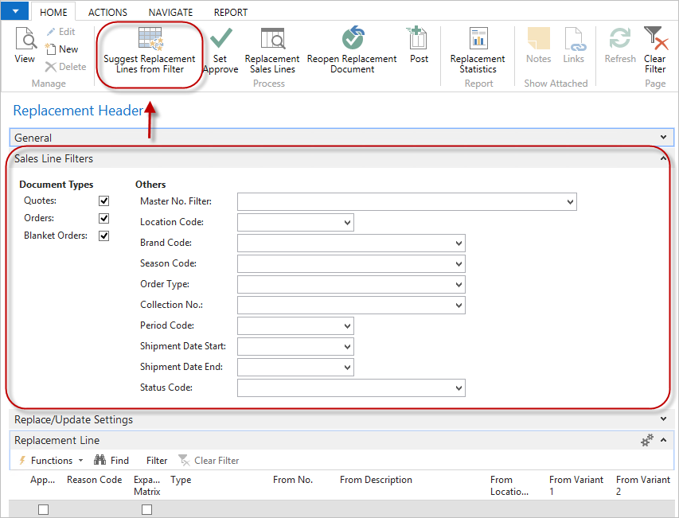
Item Sales Replacement 2018
  Suggest Replacement Lines from Filter

Slide 47
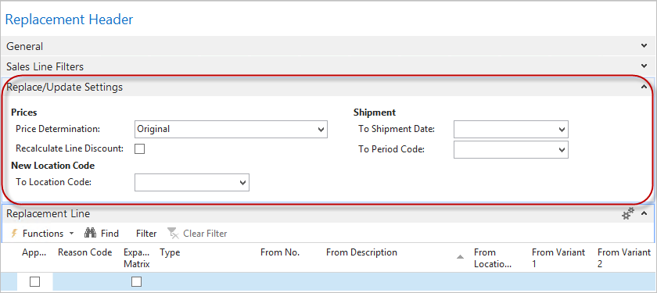
Item Sales Replacement 2018
  Replace/Update Settings

Slide 48
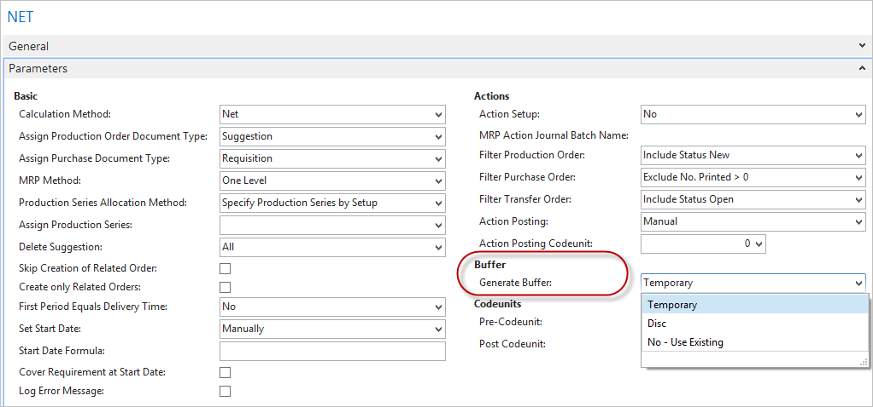
MRP – Calculation Buffer 2018
  Calculation buffer is by default created Temporary (Technical improvement)
  New Field on MRP Setup:

Slide 49
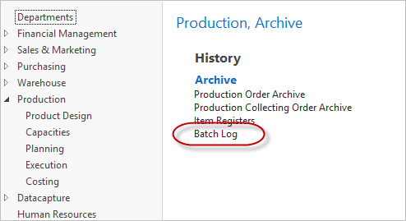
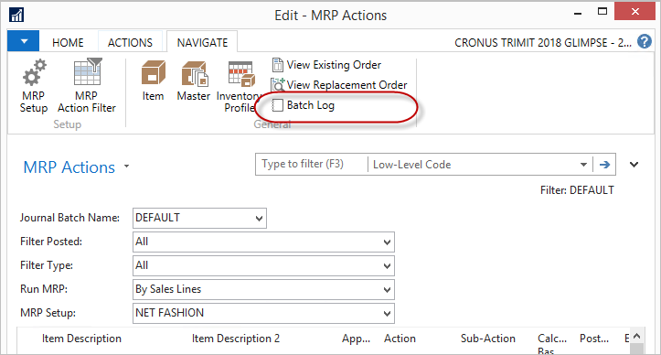
MRP - Batch Log 2018
  New Log record introduced

Slide 50
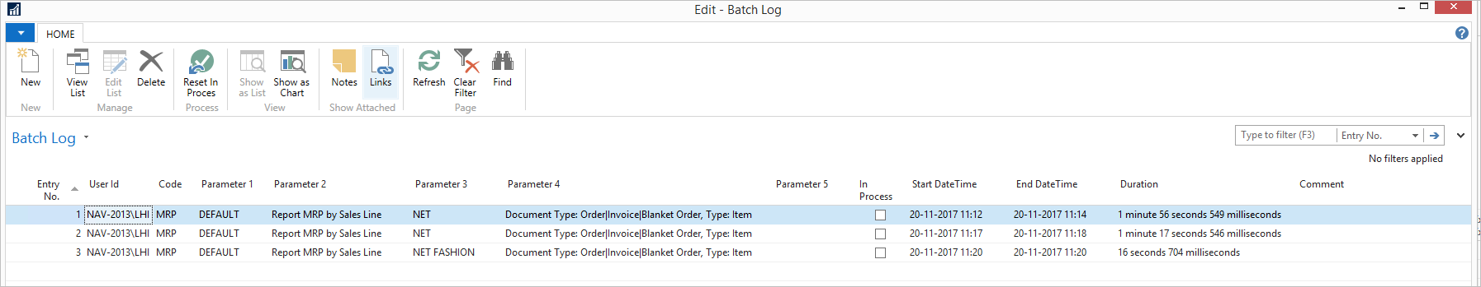
MRP - Batch Log 2018
  Prevents multiple executions of the MRP at the same time.
  If a Batch Log record with ”In Process” is found the execution of the MRP is interrupted

Slide 51
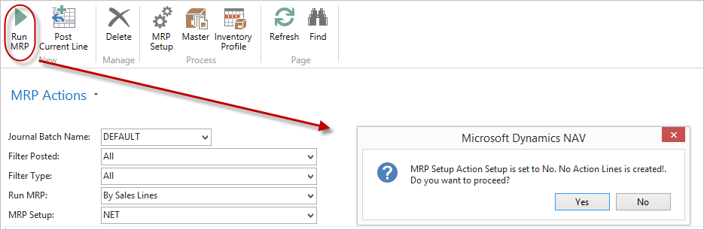
MRP – Actions 2018
  MRP Actions can be set up to be executed via Job Queue (with or without creation of action lines)
    NEW : Actions can be used on MRP Setups that do not create Action lines

Slide 52
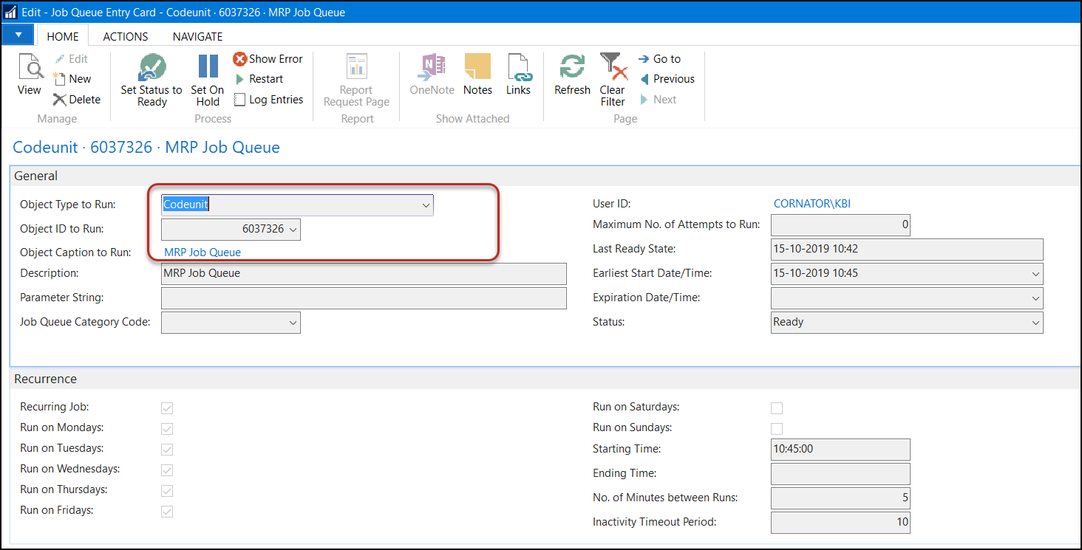
MRP – Job Queue 2018

Slide 53
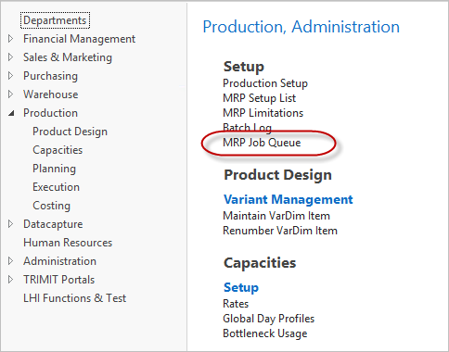
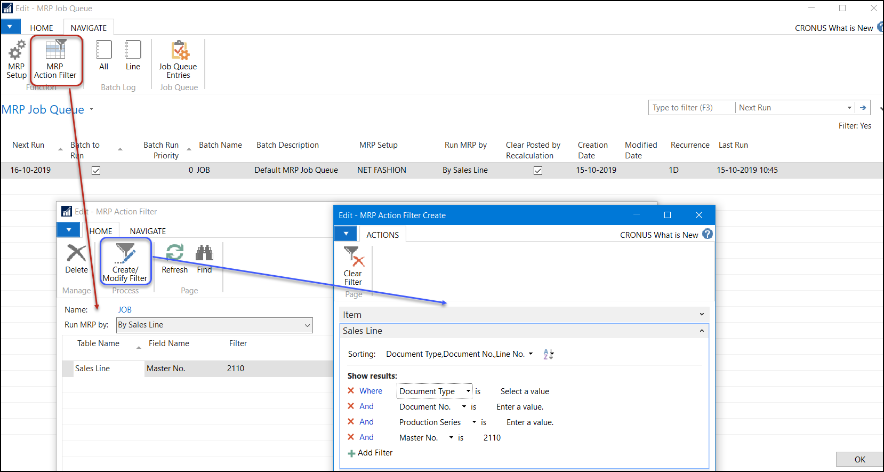
MRP – Job Queue support 2018
    The MRP Job Queue is based on the MRP Action Journal batches

Slide 54
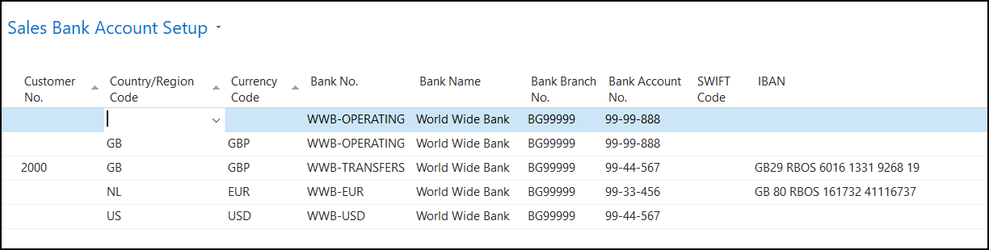
Sales Bank Account Setup 2018
If you have several Bank Accounts to which your customer could do payments based on Country/Currency, you can now set this up.
In the TRIMIT external documents, they system will then determine which Bank Account to print.

Slide 55
What’s new in TRIMIT 2018
    Bill of Materials White Paper - TRIMIT Group Filter in BOM 2018
    Where-Used New Features in TRIMIT 2018 NAV
    E-Mail White Paper - TRIMIT E-Mail 2018
    Intercompany White Paper - TRIMIT Intercompany 2018
    Replication White Paper - TRIMIT Replication of Data 2018
    Item Replacement White Paper - TRIMIT Replacement 2018
    MRP White Paper - TRIMIT Material Requirement Planning 2018
    Sales Bank Account White Paper - TRIMIT Sales Bank Account Setup 2018
    55 Ideas included New Features in TRIMIT 2018 NAV

Slide 56
TRIMIT 2018 Portals – Feb 2018
Theming in TRIMIT Portals
    Theming overhaul
    New out of the box themes
    Old themes are gone
    B2C and other portals sharing styles
    Theme changer page
Visual Configuration online in B2B and SA
    Full support for TRIMIT Configuration online including all business logic
    Visual Configuration without need for multitudes of pictures
    Item enrichment with logo, symbols, text etc.
    Fully integrated to NAV / TRIMIT

Slide 57
New/Changed in TRIMIT BC13 on Business Central Fall 2018

Slide 58
What’s new in TRIMIT BC13
Complaints
  New designed and clearer options
  Get Lines / Search Functionality
  Using Return Sales Orders for returns
  Using Return Reasons (BC), therefore included in statistics
  New Tables for Completed Complaints (instead of Boolean)
Statistics / Charts
Master Wizard expanded with Create From Blank
Matrix Print – Service to support better reports
+ General Improvements and many ideas has been developed

Slide 59
What’s new in TRIMIT BC13
Ideas included
  E-Mail Functionality for the new Sales Statistics and possibility to determine if E-Mails needs to be logged
  Bottleneck functionality now also available for Matrix Masters
  Explode BOM (of i.e. Assortments) now also available on Transfer Orders
  Create Pick Documents now available on different sorting's
  Messages regarding availability in orders changed in notifications
  Item/SKU Maintenance with extra filters regarding Assortments
  Master Analysis Matrix with extra options to show all sizes/colors
  New Role Center T_SB_WEB TRIMIT Small Business WebClient, specifically when using the Web Client.
  Functionality of Instant Reservation of Masters and of Extended Location Management have been deleted

Slide 60
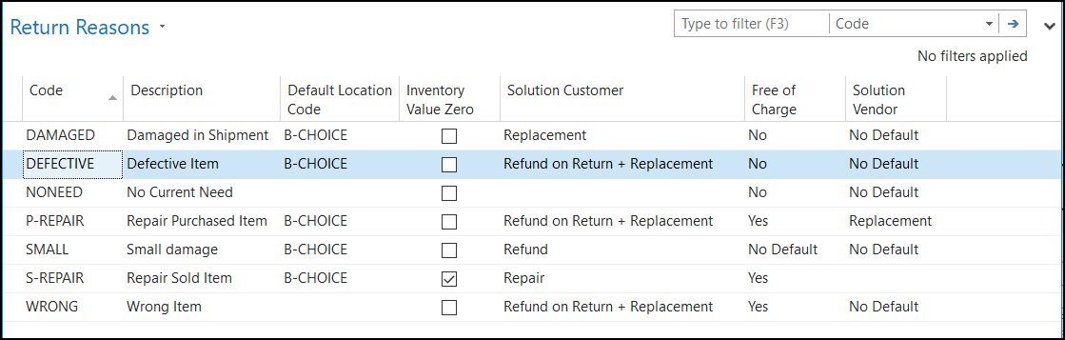
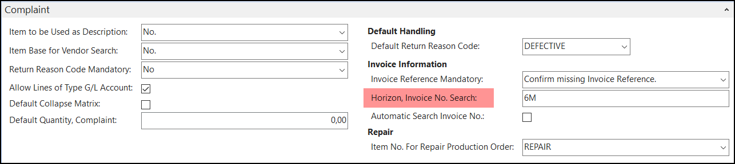
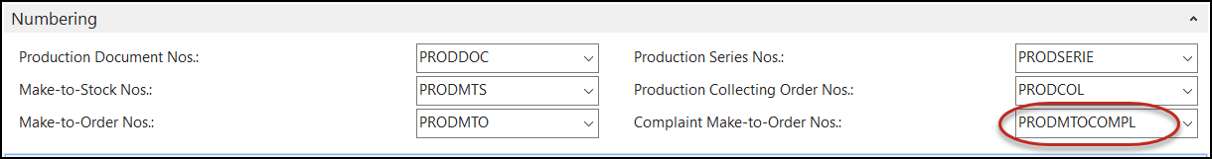
Complaints – new Setups BC13
Return Reason Codes – including defaults
Sales & Receivables Setup – some necessary parameters
Production Setup

Slide 61
Complaints BC13
Solution Customer:
Solution Vendor:
 | Sales Order | Sales Credit Memo | Return order | Production Order
 |  |  | Credit Memo when
 | New Item to customer | No Item returned | Item is returned
Refund |  | Yes
Refund + Replacement | Yes | Yes
Refund on Return |  |  | Yes
Refund on Return + Replacement | Yes |  | Yes
Replacement | Yes
Repair |  |  |  | Yes
 | Purchase Order | Purchase Credit Memo
Refund/Reduction |  | Yes
Replacement | Yes
Replacement (Drop Shipment) | Yes*
* Raised as Drop Shipment to Sales Line and Only valid if a Solution Customer is set to Replacement

Slide 62
Complaint – process BC13
Enter Header
Get Posted Sales Invoice Lines
You can import Complaint pictures
Approve Complaint
Several Options:
  Create Documents and handle the created documents manually
  Create Documents and post them via the complaint
  Create Documents & Post All Sales Document in one action
Test Complete Complaint – checks if all related documents have been posted
Complete Complaint – data is written in new “Completed Complaint” tables (6036688, 6036689, 6036690)

Slide 63
Sales Statistics BC13
New Extended Sales Statistics Setups
  Setups for different outputs (screen, chart, gauge, excel)
  Chart and gauge only in combination with TRIMIT Portals
You can set many filters up front in the setups
Based on Buffer – that needs to be updated regularly – or based on Real-time data
Setups can be used to create the docks for TRIMIT InSite Portal
Setups can be used in and Overview Setup for Order Statistics in SA and B2B
Setups can easily be used in “My Actions” of Sales Order or Customer to show statistics related to customer or masters.

Slide 64
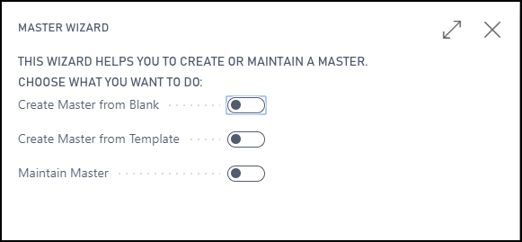
Master Wizard BC13
For creating a new Master
For copying a Master to another Master
For maintaining a Master – adding variants of VarDim Types

Slide 65
What’s new in TRIMIT BC13
Complaints White Paper – TRIMIT Complaints BC13
Statistics / Charts White Paper – TRIMIT Extended Sales Statistics BC13
Master Wizard / Create From Blank New Features in TRIMIT BC13
Matrix Print – Service New Features in TRIMIT BC13
E-Mail White Paper – TRIMIT E-Mail BC13
Item- and SKU Maintenance White Paper – TRIMIT Item- and SKU Maintenance BC13
Ideas included New Features in TRIMIT BC13
+ General Improvements

Slide 66
TRIMIT BC13 Portals – Dec 2018
InSite Portal
Actions dock on Portals Dashboard (i.e. Showing Sales Statistics for your salespersons in Sales Agent Portal)
Integration to Klarna Payments
Single page checkout on B2C (Delivery, Billing and Review areas, together with Basket content in one page)
Automatic Language detector B2C (based on browser language or customer language)
Payment Method per Country-Currency combination
Resetting password on portals
VAT-Free Pricing on B2C

Slide 67
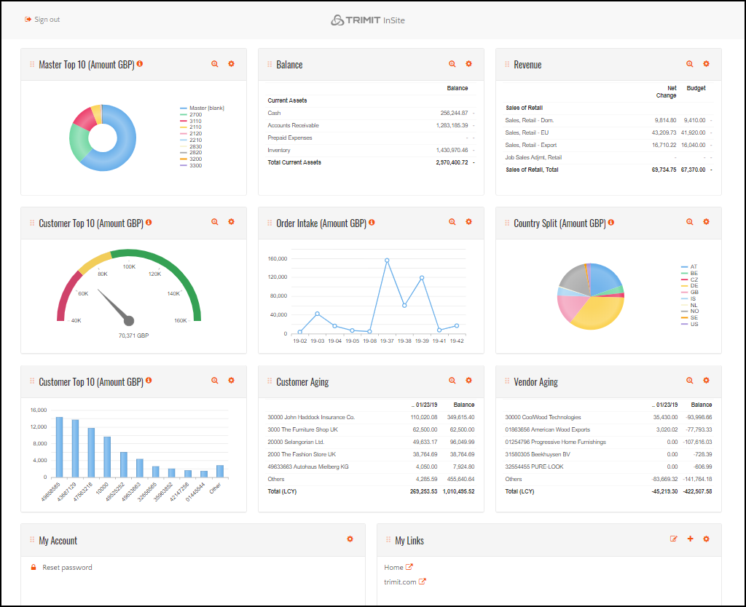
TRIMIT BC13 Portals – Dec 2018

Slide 68
New/Changed in TRIMIT BC13 R2 on Business Central Fall 2018

Slide 69
What’s new in TRIMIT BC13 R2
+ General Improvements

Slide 70
TRIMIT BC13 R2 Portals – Dec 2019
Visual configuration items on B2C Webshop
Abandoned cart notification in B2C Webshop
Back-in-stock notification on B2C Webshop
Bulk purchase on B2C Webshop
New matrix (mobile friendly) on SA and B2B on mobile devices
Item Attribute Filter
Sorting on B2C category page (price, popular)
TRIMIT InSite – New Gauges – From power Point
Facebook pixel
Standard product feeds
Google Tag Manager
Klarna integration
DIBS EASY integration (incl. Vipps)
PalPay payment integration
Charge Logic payment integration
Visual drop-down search B2C / B2B / SA
Free text search
Persistent basket
Mailchimp basic integration
ReCAPTCHA on register
Handle service items on portals
Scan to shopping list and to details page
BC benchmarking page on PIR
New (simplified) schedules setup
B2C user deletion
NON-SELLABLE items on B2C
Multiple instances setup in TRIMIT BC
Open payment setup in PIR from payment provider setup on TRIMIT BC
Category collection inheritance in TRIMIT BC category setups
Copy category
API users / API overview in PIR
Create master in PIR
Relate user to B2C
Copy documents and check-in
General Improvements

Slide 71
What is changed in TRIMIT 20.2.XXXX on Business Central 2020 Wave 2 in comparison to TRIMIT BC13 R2

Slide 72
General Remarks 20.2
All TRIMIT objects will start with “trm “
All TRIMIT fields in table extensions will start with “trm “
Back to standard BC as much as possible – besides Production
No additional TRIMIT options in BC option fields ➔ extra fields
Some specific TRIMIT functionality in separate Tables/Pages instead of in BC Tables/Pages

Slide 73
Deleted functionalities 20.2
Pre-Registration
Extended Payment Conditions
Retain Sales Orders
Sub-Supplier Work in BOM Component Lines
Codeunit Calls
Use of subscribers will in many cases be a better solution.
In all TRIMIT objects any CU Call in a procedure has been replaced by a publisher.
Pre-Defined fields in many tables ➔ needs to be done via Extensions

Slide 74
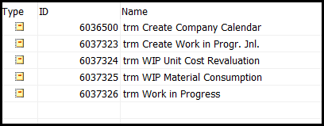
Deleted Functionality 20.2
Reports regarding costing deleted
Alternative Sorting in Languages for Care Labels Report
Creation/Changed Dates (Fields of TRIMIT) ➔ Change Log
No Caption for Item Category anymore
Contact: Customer Type and Vendor Type ➔ Customization
Type in Customer and Vendor ➔ Customization
When a customer is blocked it was possible to create Quotes. This is no longer an option - back to BC std.

Slide 75
Deleted Functionality 20.2
Tariff Numbers – field Conversion Rate
No Negative Stock possible anymore when posting Transfer orders
Sales Posting Journal
Tasklet Factory changes and objects
Include Credit Memo in Finance Charge Terms
General Journal Template Type Commission for the Commission Settlement.
Matrix Distribution Code in the VarDim Variants when choosing the Variants for a Master.
Contribution Ratio Group has been deleted from Master/Item, and therefore also the option GM for Price/Profit Calculation

Slide 76
Replaced Functionality 20.2
TRIMIT Standard Unit Cost Globally ➔ standard BC Costing Method Standard on Master/Item. Therefore costing principles back to standard BC.
But we will keep the Calculated Unit Cost fields in Items as a base for (Standard) Unit Cost, and can still use report Unit Cost Revaluation Report for revaluation.
Inventory Posting Setup – all TRIMIT fields besides Config.Variance Value have been deleted. Production Postings will now be posted to the default BC G/L Accounts; so you need to fill them
TRIMIT Unit of Measure ➔ standard BC Item Unit of Measure
Unit Cost Rounding Precision in Inventory Setup ➔ Unit-Amount Rounding Precision (LCY) from General Ledger Setup
Codeunit Call Fields ➔ Caption Class Setup
Replenishment System option Automatic ➔ new field Automatic Replenishment

Slide 77
Replaced Functionality 20.2
Company Calendar ➔ Base Calendar of BC
Sales Prices Type options Company Group, Chain, Bill-to, Campaign Price List are deleted.
If Type is Customer it will search for Company, Bill-to, Company Group and Chain.
Campaign Price List is replaced by Campaign but will be the same functionality.
Sales Line Discount Type, By Bill-to, By Company Group, By Chain, By Country will be deleted (see Sales Price Type). Now needs to be entered via the Sales Line Discount Types (not via Master, Item or Customer anymore)

Slide 78
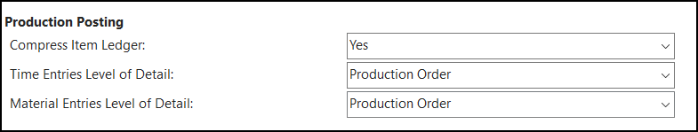
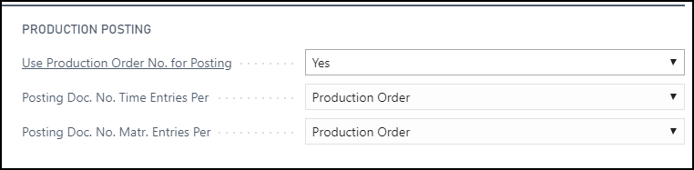
Replaced Functionality 20.2
Production Setup fields renamed
Customer Price Group: TRIMIT Fields now in separate Price Group Parameters.
Costing Method NINO replaced by (Item) Type Non-Inventory
Field Priority in Item Vendor removed ➔ New field Default Vendor
New report 6036660 trm Adj.Exch.Rates Sales/Purch instead of TRIMIT functionality added to standard report 595 Adjust Exchange Rates.
New report 6037310 trm WhseSource Create Doc. created instead of TRIMIT functionality added to standard report 7305 Whse.-Source - Create Document
Profile (Role Center) TRM_SB_WEB TRIMIT Small Business WebClient is now renamed and replaces the old TRM_SB TRIMIT Small Business

Slide 79
Replaced Functionality 20.2
Advanced Lookup in Sales & Receivables Setup and in Purchase & Payables Setup has been replaced by Lookup Filters in an Order Type
Report Layout Settings to set all kind of parameters for the TRIMIT Reports that determine how the document is printed. This will replace the Variables that were set in the C/AL Code of these Reports.
  Sales Quote, Sales Order, Sales Shipment, Sales Invoice, Sales Credit Memo, Pick Document per Order, Purchase Order (6036700 – 6036730)

Slide 80
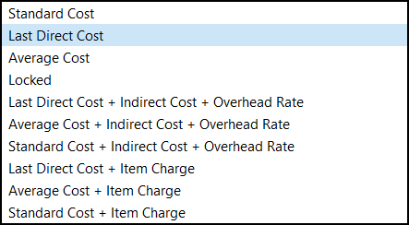

Changed Functionality 20.2
Provision Sales/Purchase - only one combination of Gen. Bus. Posting Group, Gen. Prod. Posting Group and Calculation Base Provision is allowed
Calc. Base Calc Unit Cost is now called Base Calc. Unit Cost Material
Entry Type in transaction Tables back to standard options (Purchase, Sales, Positive Adjmt., Negative Adjmt., Transfer, Output, Consumption).

Slide 81
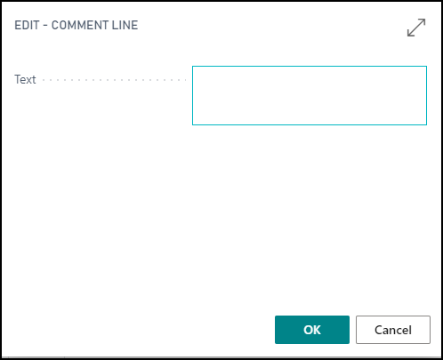
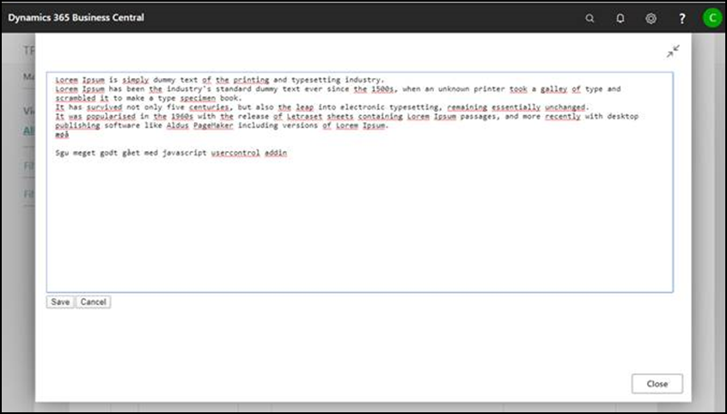

Changed Functionality 20.2
The Text Editor in the Modern Client is now much bigger as the small square it was before.
Parameter Maintain Picture in Bricks is not in the Inventory Setup anymore. It is now an action in the Pictures List:

Slide 82

Changed Functionality 20.2
In Profile TRM_PROD TRIMIT Production we also added functionality of TRIMIT Shop Floor Application. This will only be shown if you also installed the TRIMIT Shop Floor Application.

Slide 83

Changed Functionality 20.2
For Production and Shop Floor, we now have a new Parameter for choosing the Base Calendar Code (instead of the Company Calendar) that will be used to calculate the Start-/End Dates of Production orders.
This will also determine the actual non-working days.
E-Mail Template – sorting of FastTabs has been changed.
Setting up Group Filters for the BOM Line has been changed.
Optimized creation of TRIMIT Pick Documents, which will reduce the time needed.

Slide 84
New Functionality 20.2
Closing Production Orders – for posting the final variances.
Only closed Production Orders can be archived.
New Parameters in Production Setup:
- Close Inventory Production Orders at Finishing
- Close Order Production Orders at Finishing
- Automatically Archive Production Orders at Close
Closing Production Collecting Orders – for closing all the related Production Orders.
Replication over databases and Filters for Table Content
Report 6036650 trm Customer Statement for the Statement (116) when using TRIMIT E-Mail functionality.
Report 6036651 trm Reminder for the Reminder (117) when using TRIMIT E-Mail functionality.
Report 6036652 trm Finance Charge Memo for the Finance Charge Memo (118) when using TRIMIT E-Mail functionality.

Slide 85
New Functionality 20.2
Time Rounding Precision (in hours) in Production Setup.
If empty set to 0,00001
Additional Comments can be shown in FactBoxes in Measurement Chart or BOM – new fields in Additional Comments Show in Measurement Chart, Show in BOM.
Master Analysis Matrix – extra option for Only Current Company (in case of Intercompany structure)
Generate Summary Invoices by Batch Posting – new Parameter in Sales & Receivables Setup.
Report 6037061 trm Inventory Valuation WIP now also including filters on Production Orders
In Production now also Lot Nos. and Serial Nos. possibility (roll administration), including automatic creation of Lot Nos. or Serial Nos. when finishing Production Orders

Slide 86


New Functionality 20.2
You can now determine if the M/C Factor in an Operation is related to the Operation Time or Machine Time. Therefore, a new parameter in the Production Setup: Time Registration Calculation.
New Profile (Role Center): TRM_PROD TRIMIT Production (page 6036306)
TRIMIT Help based on W1 in English now available in the TRIMIT Role Centers via a direct link.
https://help-bc.trimit.com/main.aspx?lang=en-US&content=index.html
I.e. in TRIMIT Small Business:

Slide 87
New Functionality 20.2
Profile (Role Center) of TRIMIT Small Business now also includes Production Orders, Production Collecting Orders and MRP Actions
In Basic Setup a new Parameter:
Generate Timeline Data for Charts
Sales Analytics Request- easy view of Sales Statistics by choosing level by level manually or by using the Extended Sales Statistics Setups.
TRIMIT Shop Floor Application – previous known as TRIMIT Datacapture. If installed, you will also see some TRIMIT Shop Floor programs in the Production Profile (Role Center)

Slide 88
New Functionality 20.2
In the Wizard for copying Masters, we added the possibility to copy SKU’s.
TRIMIT Add-ins are replaced by an API Service for Picture Management in regards to an installation in the Cloud.
For an on premises installation, you can still use the TRIMIT Add-ins
In the VarDim Type, you are now also able to enter the VarDim Sales Prices for all Masters/Items.
Availability Check based on Underlying Level of a Temporary BOM, even if the Related Order has not been created yet for an Item.
Procedure (trmCallValidateQtyBase) for handling entering Quantity (Base) in Sales, Purchase, Transfer Lines and Item Journal Lines (for developers/customization)
In TRIMIT Pick Document now also the possibility to attach Lot Nos. and Serial Nos. via the Item Tracking Lines

Slide 89
New Functionality 20.2
Copy Sales Document Setup for specifying in detail what you want to copy, if you want to copy Header and/or Lines of an existing Sales Document in a new Sales Document.
In the Item Inventory Profile, you can see the Available Qty. even based on future demands by using a lookup to see the details.
New fields in the Report Layout Settings for the Sales Order Confirmation: Print Order Confirmation if Total Amount is Zero and for the Purchase Order: Print Order if Total Amount is Zero.

Slide 90
What is changed in TRIMIT 21.1.XXXX on Business Central 2021 Wave 1 in comparison to TRIMIT 20.2.XXXX

Slide 91
New/changed Functionality 21.1
New Inventory Profile Matrix Report (6037014) that can show you the quantities per process (Sales, Purchase, Production, etc.)
Page Task (6038422) will be showing more fields by default.
Output for the PDM (Master) Reports (6037208), can now also be send to File List
New parameter in Inventory Setup: Suppress Dialogs Pick Update & Posting to suppress the dialogs during the posting of Pick Documents (i.e. if run via Job Queue).
Item Tracking Lines connected in a Related Order will also be copied to the level above:
  Purchase Line -> Sales Line
  Purchase Line -> Production Order Line
  Production Order -> Sales Line
  Production Order -> Production Order Line

Slide 92
New/changed Functionality 21.1
Extended functionality regarding Campaign Prices:
  Campaign Price Calculation Type can be:
    Price List – Campaign Prices based on a Sales Price with Type Campaign.
    Calc. Base Price Group if line exist – one Price List related to another Price List for the Campaign Prices.
    Mix & Match – a minimum quantity of several Items can all get a special Price
    Get one for free – if you buy a specific Quantity, you get 1 piece for free
  For every Campaign Price, you are also able to determine an extra image that ill be shown on the Portals, to highlight the Campaign: Visual Campaign Code in the Price Group Parameters
New field Skip VAT Recalculation in the Price Group Parameters
  Setting this field to Yes, makes it possible to have the same Sales Price incl. VAT cross different Countries with different VAT Percentages.

Slide 93
New/changed Functionality 21.1
In the Role Center TRIMIT Small Business, there is now a link Setup to many setup programs.
In the Pick Document per Order List, you are now able to post several Pick Document/Orders at the same time, by selecting the rows and click Post
In the Role Centers of TRIMIT Small Business and TRIMIT Production we also added a direct link to Production Journal
Via the Lines of a Posted Purchase Invoice or a Posted Purchase Credit Memo, you are now also able to see the VarDim Order (Line, VarDim, VarDim Order)
New Parameter in Sales & Receivables Setup:
Availability Check on Make-to-Order Items to prevent an Availability Check calculation in Sales Line if there will be a Related Order created.

Slide 94
New/changed Functionality 21.1
New Report: Reschedule Sales Lines Based on Availability to change Shipment Dates on Sales Lines with Replenishment Policy Inventory, based on Availability that can be based on the dates of the Purchase-/Production Orders.

Slide 95
What is changed in TRIMIT 21.2.XXXX on Business Central 2021 Wave 2 in comparison to TRIMIT 21.1.XXXX

Slide 96
New/changed Functionality 21.2
Report 6036730 trm Purchase Order can also include the pdf-files of the Master Reports – if send by E-Mail – of all the Masters on the Purchase Order.
Measurement Chart Versions has been extended with the fields Global Dimension 1, Global Dimension 2, Collection No. and Shipment Group
New Standard Comments for the Additional Comments of the Master
AL Code in external reports for Customer Statement, Reminder and Finance Charge Memo changed for getting the right Sales Bank Account Setup.

Slide 97
New/changed Functionality 21.2
New functionality to see/maintain the Files and Folders you have in your Azure Storage Services in TRIMIT based on Connections Setups, File Shares and File Explorer.
New field in Item Tracking Code for Production Orders: Create Tracking For: Outstanding Quantity (one Tracking Code per Order) or Quantity to Finish (Tracking Code per Finished Quantity)
Shop Floor
  Finishing Production Order when registering Time of last Operation
  Only use for Tasks or also for Indirect/Absence Time registration
  Default Terminal Menu will be created when installing Shop Floor
  Block Terminal Close Login Page parameter in Shop Floor Setup to keep the Terminal Login Page Open all the time

Slide 98
New/changed Functionality 21.2
Show in Alternative Currency option for the Extended Sales Statistics Setup, to see the Statistics in another Currency as LCY.
Additions regarding Intrastat as of January 1st 2022:
  Transaction Type Transfer Orders field in the General Ledger Setup – this should be set to 31: Transport to or from a storage room (excluding on-demand stock and consignment
  Transaction Type Direct Trade in the Sales Channel for the specific Transaction Type of Direct Trade – this should be set to 12: Direct trade with/by private consumers (incl. distance selling) in the Sales Channels that are used for i.e. the B2C and InStore Portal Profiles.
In E-Mail Templates a new (mandatory) field for Email Account to determine the Sender Name and Sender E-Mail. The Fields Sender Name and Sender E-Mail will be deleted

Slide 99
New/changed Functionality 21.2
New Action All Category Lines in page trm Category Lines (6038122) to show all the Category Lines regardless the Parent No.
In page trm Prod Collect Orders List (6037319, List), we added the Status of the PCO.
Easy way to see several related Pictures of a Master: simply by clicking > in the FactBox of Master Pictures
New Parameter Default Matrix Distribution Method in the Sales & Receivables Setup and in the Purchase & Payables Setup
You can now use the Matrix Distribution functionality without pre-defined Codes.

Slide 100
What is changed in TRIMIT 22.1.XXXX on Business Central 2022 Wave 1 in comparison to TRIMIT 21.2.XXXX

Slide 101
New/changed Functionality 22.1
New Parameter Direct Unit Cost Date Handling in the Purchase & Payables Setup to determine if Purchase Prices should be based on the Order Date of the Purchase Header or the Expected Receipt Date of the Purchase Line. This field is also available on the Purchase Header itself.
Body of an E-Mail Template can now be filled based on an import of a txt- or html-file.
Connection Setup – for replicating data from TRIMIT ERP to TRIMIT Portals – can now also be setup for Cloud Replication with OAuth 2.0 Authorization.
In Item List page (31) a direct link to Sales Prices, Sales Discounts, Sales Prices and Discounts Overview and Sales Price Worksheet.

Slide 102
New/changed Functionality 22.1
In Portal Setup new parameter Delete Posted Portal Sales Document based on Sales Order Deletion during Invoice Posting (automatically) or based on batch report (manually)
Table 6038129 trm Portal Customer Templates has been replaced by 6038160 trm Portal Customer Templ. because of extending the field Customer Template that is in the primary key.
Additions regarding Intrastat as of January 1st 2022:
  New fields in General Ledger Setup to set default Transaction Type 22 (Replacement of goods returned) and 23 (Replacement of goods not returned).
  22 and 23 will be set for Replacements Sales Orders created via Complaints depending if it is a Refund on Return or only a Refund.

Slide 103
New/changed Functionality 22.1
New option in Order Type for Availability Check to Skip Availability Check if no Transactions are available.
Table 6038162 trm Portal User Register will replace
6038149 trm B2C User Register
New EU Sales Reporting Filters and Correct Customer VAT Reg. No. functionality for the EC Sales List Reports.
New Parameter in Sales & Receivables Setup: Forced Currency Match. When set to Yes, it makes sure that a Sales Price with Currency Code of the Customer will always overrule a Sales Price without Currency Code; even if the Start Date is later.
Last Changed Date/Time shown in File Explorer or File Share.

Slide 104
New/changed Functionality 22.1
3 extra AddOn Apps when working with 3rd party Apps:
  TRIMIT AddOn Mobile WMS App in case you work with the TRIMIT Pick Documents and use Tasklet Factory.
  TRIMIT AddOn Document Capture App in case you work with Continia Document Capture 365 for creating the right Matrix Lines in a Purchase Document.
  TRIMIT AddOn ForNAV in case you work with ForNAV App and want to use the ForNAV approach of documents for the TRIMIT External Sales Documents (Quote, Order, Shipment Invoice) and the PDM Reports (Master, Bill of Materials, Measurement Chart, Additional Info, Additional Comments, Composition and Care Label).
Change in Master with Sequential Number (MMMLLLL)
  Match Search in the Master will have 3 options: No, Yes, and Select Lines (VarDim Item) – so you are able to select only a few VarDim Types that should match to determine the existing Item No. or to create a new Item based on a configuration in a Sales Line.
  In the VarDim Item you can determine which VarDim Types should match
Now the Master with Sequential Number can also be used on the TRIMIT Portals.

Slide 105
New/changed Functionality 22.1
When Production Collecting Order Status is set back from Released to New, you can also set all underlying Production Orders to New.
In Customer List/Card via Related, Customer, Store Locator List, you can now see the Stores (Where to Buy Stores) that are based on the Customer or its Ship-to Addresses.
In Replacements you are also able to filter Sales Lines based on Status Code in the Collection Master Relations or Matrix Limitation Master Relation
Report 6037036 trm Create Items to create Items for multiple Masters at the same time.

Slide 106
New/changed Functionality 22.1
New fields in Pick Document Header/Line: Assigned User ID, Assignment Date, Assignment Time
Extra options in Extended Sales Statistics Setup: Unit Cost (based on Document Line or Adjusted Unit Cost) and Always Quantity from Sales Credit Memo (even if no Items were returned).
New page Statistics Data Warehouse (6036864)
New field in Container Header for Filter Direct Transfer for attaching and handling Transfer Order with a checkmark in Direct Transfer.
New field in Pick Document per Order Header: Complete Shipment of Sales Lines to set the corresponding field in the Lines if the Quantity Picked < Quantity Requested.

Slide 107
New/changed Functionality 22.1
Attaching Pictures to Variants of a Master does not require to choose “Specific” anymore; that will be set by default
New field in VarDim Type: Use Value as Type Code (.A or -50 will be accepted as value for the Variants)
If Use Warehouse Functionality in the Inventory Setup is set to Yes, also the Check Availability by Location in the Sales & Receivables Setup must be Yes.
New field Default Adjust Line Discount in the Price Group Parameters, to set the Line Discount % in Sales Lines when the Price Group Parameters are applicable. And you can determine if the highest or lowest Discount should be taken between the regular Line Discount and the Campaign Default Adjust Line Discount.
New option in Master Analysis Matrix: Use Collection No. Filter for Master based on to determine if a Filter on the Collection No. should be checked with the Collection No. in the Master Card, or with the Collection/Master Relations

Slide 108
New/changed Functionality 22.1
Improvements for Assortments:
  Easier entering quantities per size for several Assortment Codes in a special VarDim Type of Type = Code for the Assortment Codes.
  Using the content of Assortment Codes in a special VarDim Type of Type = Code when you add an Assortment Size in a regular Size VarDim Type, so the Assortment Sizes will be shown in a regular Matrix. The Bill of Materials for the Assortment Items will be created automatically based on the content of the corresponding Assortment Code in a VarDim Type of Type = Code.
New Table Information Editor to see content of a specific Table and even the possibility to replace the content of a value in a specific Field by another value.

Slide 109
New/changed Functionality 22.1
In the Extended Sales Statistics and the Sales Analytics, you can now also filter on the Campaign (based on the Price Group Parameters of TRIMIT).

Slide 110
What is changed in TRIMIT 22.2.XXXX on Business Central 2022 Wave 2 in comparison to TRIMIT 22.1.XXXX

Slide 111
New/changed Functionality 22.2
TRIMIT Editor or Comments/Text, can now also handle HTML in the Editor itself. The only place – for now – where it actually results in a different format of text is in the E-Mail Template for the Subject and the Body.
Table Information Editor can now also change Data of a Field based on a Related Field. I.e., you can change the Salesperson of Sales Orders based on the Salesperson of the Sell-to Customer.
You can see all related Pictures of a Master, regardless if it is a Picture of the Master, of a Color, of the Measurement or Additional Comments.
Drag and Drop Pictures to the Master List, Master Card, Variants, Pictures List to easily connect Pictures.
New field Skip External Service Resize in Basic Setup if you don’t need the resizing of imported pictures and to make sure it will go much quicker in case the TRIMIT Service for this resizing might not be available.
If no Unit List Price (Retail Price) should be printed on a Sales Document – based on the Report Layout Settings - the Unit of Measure of the Sales Line will be printed (in the standard TRIMIT Reports)
New field Price Group Retail Unit Price in Customer, which will overrule the corresponding field in the Sales & Receivables Setup in the TRIMIT Sales Document Reports and on the TRIMIT B2B or Sales Agent Portal
New option Price Group Retail Unit Price in Report Sales Book to determine the Retail Prices that will be printed on the Report
TRIMIT Permissions Sets changed from XML based sets to AL based sets
Preview of TRIMIT API Integration that is coming.

Slide 112
New/changed Functionality 22.2
Matrix Inventory Profile page can show Inventory Profile of all Colors of a Master and even of several selected Masters at once.
Drag & Drop functionality for adding Attachments added to many sale-/purchase lists/cards and to the Variants of a VarDim Type.
Reference Color Table to import RGB Color Codes, RAL Color Codes and Pantone Nos. including corresponding Color Pictures
RGB Code in VarDim Type Variant Options to create and connect automatically the right Color Pictures
Resizing Pictures will now be handled by standard BC functionality regarding BLOB fields and not via external Service.
In FactBox Item Transactions from a Sales-/Purchase Line now also the Quantity to be Picked

Slide 113
New/changed Functionality 22.2
New Parameters in Inventory Setup:
  Allow Update Standard Unit Cost Without Revaluation
  Skip Update Unit Cost from Related Order
Report Post-Calculation can also be run via the Archived Production Order Card/List
The action Update Direct Unit Cost in the Purchase Prices can also change the Std. Unit Cost Material from an Item automatically
The action Post Purchase Prices in a Calculation can also change the Std. Unit Cost Material from an Item automatically
Group Master can now be changed on the Master Card itself
Drag & Drop functionality for dropping pictures also available in the VarDim Type List/Card for dropping VarDim Type pictures and VarDim Type Variant Options pictures – even when using a zip-file.

Slide 114
New/changed Functionality 22.2
Sustainability
  You can add Sustainability in Master and Vendor based on VarDim Types
  You can set up to four Sustainability VarDim Types in the Inventory Setup and the Report Layout Settings
  You can see the totals in the Statistics of a Sales Order
Extended Text in HTML format (used on Standard Text, Master Additional Comments, Master Extended Text, etc.), only editable via the Editor.
Picture Resizing:
  Default Picture dpi in Inventory Setup
  Logo Box Width (cm), Logo Box Height (cm) and Logo Placement Code in the Report Layout Settings
  AL Code changes so you can now set the centimeters for resizing pictures instead of pixels.

Slide 115
New/changed Functionality 22.2
Extra Data in our TRIMIT Data and Test App
  VarDim Types regarding Sustainability
  Sustainability Values on Masters
  Report Layout Settings
Drag & Drop in the Additional Comments of Masters
Dimensions on Related Orders based on Dimension Purchase Order and Dimension Production Order in the Dimensions

Slide 116
What is changed in TRIMIT 23.1.XXXX on Business Central 2023 Wave 1 in comparison to TRIMIT 22.2.XXXX

Slide 117
New/changed Functionality 23.1
TRIMIT E-Mail functionality can:
  Store Attachments in Azure File Storage instead of in the database itself
  If you log E-Mails, it will be in the BC Outbox Email and Sent Email.
  TRIMIT E-Mail Log Entries will not be used anymore for new logged E-Mails, but you are still able to view them.
  Delete E-Mails Log (report 6037700) extended with extra options:
    Update Duplicates between Log Entries and Sent Mail
    Delete Only Duplicates between Sent Mail and Log Entries
    Delete Archived Attachments from Log Entries
  New reports:
    Delete Sent Emails (6037701)
    Update E-Mail Log Entries From Template Settings (6037702)
    Update Sent Emails From Template Settings (6037703)

Slide 118
New/changed Functionality 23.1
In the Order Type fields Status has been “renamed” to Status Sales and a new field Status Purchase has been added – which will get the same value as the original field Status when upgrading.
In the Matrix Inventory Profile, you are now able to set an actual Filter for the Y-Axis, instead of only choosing one Value, and negative Available I and Available II quantities will be in shown in red.
In the Basic Setup a new Parameter Environment is a Sandbox so new E-Mails are accidently send to actual Customers if you are working in a test environment like a docker or sandbox.

Slide 119
New/changed Functionality 23.1
In the Item Inventory Profile, the Expected Inventory will be shown in red if the quantity is negative.
In the Inventory Profile Components, the quantities of the Components will be shown in red if the quantities are negative.
In the Workflow the Lines will be shown in red if the Deadline is before the Work Date.
Extra Action in Portal View List to simulate getting Data from the Portal.
Extra Date Filter in “Get Posted Invoice Lines” for Complaints if there are more than 50 Posted Invoices.

Slide 120
New/changed Functionality 23.1
Action Copy Values in Master List/Card and Collection/Master Relations can now also copy Sustainability Information.
New Report Sustainability via the Master Card.
PDM Report Set can now also have reports of Report Type Sustainability.
Based on the Sustainability VarDim Type 1 – 4 in the Report Layout Settings, the Sustainability Totals will be printed on the Sales Reports.
New field Exclude Sales Print in the VarDim Master, which prevents printing the VarDim Type/Value on Sales Documents (Quote, Order, Posted Invoice).

Slide 121
New/changed Functionality 23.1
Action Copy Values in Master List/Card and Collection/Master Relations can now also copy Additional Tags.
New Filters and Combinations to create Pick Documents in the Pick Limitations:
  Filter Shipment Method Code
  Create Pick Document per Shipment Method Code
  Create Pick Document per Order Type
Portal User Relations can now also be viewed via the Customer, Vendor and Salesperson.
The layout of the TRIMIT Activities Card has been optimized, zo you see all the Comments in the page itself.
The Container List Report is now also showing the Related Container Nos.

Slide 122
New/changed Functionality 23.1
Replication and Connect Setups has been improved
  Parameters can also be used for External Replication to change Data from the Publisher before importing in the Subscriber.
  Extra Batch Size in the Connection Setup to avoid Timeout Errors.
  Right Lookup for the Company Name in the Connection Setup.
  While replicating Data it will use the Related Company from the Subscriber and not the Company Name of the Connection Setup (in case of an External Replication). This enables several External Subscribers from the same database but with different Companies.
  For external Replication you are now able to Use OData Web Service protocol.
Category Lines can now also have a Filter for Additional Info of Masters.

Slide 123
New/changed Functionality 23.1
New Posted Document List Range Date Formula in the B2B Portal Profile and Sales Agent Portal Profile to limit the shown Posted Sales Invoices and Posted Credit Memos on the B2B Webshop and Sales Agent Portal.
Additional Comments can be related to specific Collection No., Shipment Group, Global Dimension 1 and/or Global Dimension 2.
The Measurement Chart Version, can also be specified for a specific Collection No., Shipment Group, Global Dimension 1 and Global Dimension 2, and therefore only show the Additional Comments in the Measurement Chart that are applicable based on the corresponding Collection No., Shipment Group, Global Dimension 1 and/or Global Dimension 2.
E-Mail Template Code in the Report Layout Settings.

Slide 124
New/changed Functionality 23.1
In the Portal Profiles for the B2B Webshop and the Sales Agent Portal you can determine if you want to see the Sales Prices in the Columns (X-Axis) or Lines (Y-Axis) of the Matrix of a Master or if you do not want to see (None) the Sales Prices in the Matrix.
Improvements in the Pick Documents:
  Red Lines in Reallocation if Quantity to be Picked < Quantity Requested.
  Action Reallocation in the Pick Document List.
  See all Reallocation Lines of a specific Master/Customer, Customer or Sales Order in a specific Pick Document.
TRIMIT File Shares and File Explorer, can also be used for Local Files and not only for Azure Files and Azure Blobs.

Slide 125
New/changed Functionality 23.1
Improvements in TRIMIT Shop Floor
  New field in Terminal Menu: Embed Tasks List in Terminal to show all the Tasks that an Employee can work on, so it is easier to choose the right Task to start.
  In the Terminal also the possibility to enter the Material Registrations – the consumptions of the Materials in a production Order based on the Active Task the Employee is working on.
  Extra fields in the Tasks list: Item Description 1 and 2 of the Item that needs to be produced and the Operation Description.
  When Ending a Task, the possibility to set a Task to Finished, so it will not show up again in the List of Tasks that an Employee can work on.
New page Intercompany Transaction Log to show the connections between an Intercompany Purchase Order in a Subsidiary and the corresponding Intercompany Sales Order in the Headquarter.

Slide 126
New/changed Functionality 23.1
New fields in Operation regarding Shop Floor:
  Finish Task to determine if the End Task Dialog should appear
  Allow Adjust. of Operation and Machine Time to determine if the Employee can change the consumed Time in the End Task Dialog.

Slide 127
What is changed in TRIMIT 23.2.XXXX on Business Central 2023 Wave 2 in comparison to TRIMIT 23.1.XXXX

Slide 128
New/changed Functionality 23.2
TRIMIT External API functionality available for exporting Master/Item Data, Sales Prices, Inventory/Availability, Customer Data, Posted Sales Invoices, Posted Credit Memos and importing Sales Documents (like Quote, Order, Return Order, Invoice and Credit Memo).
TRIMIT Text Editor is replaced by standard BC Text Editor, which enriches the possibilities of the layout for i.e., the E-Mail Templates Body.
Dimension for Related Order will also be inherited if the Item does not have any Dimensions based on the settings in the Dimensions.
Connection Setup now also includes Type Taskrunner to be able to run codeunits or reports in the database itself or using the TRIMIT Web Services to connect to another database.

Slide 129
New/changed Functionality 23.2
In Measurement Chart Cells will be shown red is the difference between the Grading Point and the Value in the Cell exceeds the Tolerance.
Content of Assortment Items – regardless if it is on Variant 1 or Variant 2 – can be created automatically based on a VarDim Type, in which the Variant 1 or 2 is set as the Assortment VarDim Type.
New Parameter in Shop Floor Setup: Time Unit for End Task to determine if you want to enter Hours or Minutes when ending a Task in the Terminal Menu.
New Action in the Pick Document per Order List: Delete line if “Quantity to be Picked”=0 to delete Pick Document per Order if all the Lines have nothing to Pick anymore because of Reallocation.

Slide 130
New/changed Functionality 23.2
You are now also able to upload a picture on Sales Quote Line, Sales Order Line and Sales Invoice Line by dropping a picture in the Drag & Drop FactBox.
A Sales Line of Type Template and a No. with Phantom Item is Yes, can now also have a Quantity and the Bill of Materials can be exploded.
New options regarding printing text of the Additional Comments in txt-format or HTML-format.
Changed setup of Customer/Salesperson Relations to determine for which Customer a Salesperson can enter Orders on the Sales Agent Portal.

Slide 131
New/changed Functionality 23.2
The TRIMIT Data & Test App is now also able to create Posted Sales Invoices, so you are also able to see TRIMIT Statistics in a demo environment.

Slide 132
What is changed in TRIMIT 24.1.XXXX on Business Central 2024 Wave 1 in comparison to TRIMIT 23.2.XXXX

Slide 133
New/changed Functionality 24.1
Fields trm Type and trm No. in Sales Lines and Purchase Lines are replaced by standard BC Type and No. with the same options.
Field trm Default Type Sales Lines in Sales & Receivables Setup is replaced by standard BC Document Default Line Type; content is the same.
Field trm Default Type Purchase Lines in Purchase & Payables Setup is replaced by standard BC Document Default Line Type; content is the same.
Retention Policies extended with several TRIMIT Tables.
New Cleanup Methods to change/delete Data when Copy Sandbox, Copy Company or Periodic Cleanup.

Slide 134
New/changed Functionality 24.1
In Document Attachments a new field Relation which can be <empty> or Sustainability – simply informative.
Purchase Line Type now also including Template, just as in the Sales Lines.
New TRIMIT Delogue PLM Integration App for the integration between TRIMIT and the third-party software of Delogue.
In the Pick Document Limitations, we added the option to create Pick Documents per Order.
Possibility to show/update custom fields in the Matrix of a Sales Line, Purchase Line, Production Collecting Order Line, Item Journal and Warehouse Shipments.

Slide 135



New/changed Functionality 24.1
In Replication Publisher a new Action to Show number of records in the Company.
In Replication Subscriber a new Action to Show number of records in the Replication Log of the Publisher Company after the Initial Replication.

Slide 136
New/changed Functionality 24.1
Quantity to be Picked in TRIMIT Pick Document based on Related Order:
  When creating TRIMIT Pick Document Lines for a Sales Line with a Related Production Order, the Quantity to be Picked will be the Quantity Finished of the Production Order.
  When creating TRIMIT Pick Document Lines for a Sales Line with a Related Purchase Line, the Quantity to be Picked will be the Quantity Received of the Purchase Order Line. If the Purchase Order is already invoiced completely and therefore has been deleted, it will take the Quantity on the Related Posted Purchase Invoice.
  It will not take into account any Inventory Quantities or suggest Quantities from other Production/Purchase Orders.

Slide 137
New/changed Functionality 24.1
New Parameter in Sales & Receivables Setup:
Retain Sales Header Fields if Ship-to Address fields are Blank.
If set to Yes, a blank Shipping Agent Code in a Ship-to Address will not overwrite a filled (Shipping) Agent in the Sales Header.
Assortment Items need to have Unit Price Calculation Method Price List, if it should be able to have Campaign Prices (Price Group Parameters) Type Get 1 for free or Mix & Match. Otherwise, you will get a message when you want to connect the Master/Item in Items in Campaign.
When copying a Master by Wizard, the Sales Prices of Type Campaign will not be copied.
The Attachments of E-Mails, created via the TRIMIT E-Mail Templates, can now also be Logged in File Share Directories.

Slide 138
New/changed Functionality 24.1
For the importing of Sales Order via the Integration List (TRIMIT External API functionality), it is now also possible to import Comment Lines for the Header or for the Sales Lines.
In the MRP Setup a new field has been introduced:
Only Create Related Orders for Released Sales Documents,
which will prevent that Related Orders might be created for “Open” Documents.
New field Formula Sales Header (not visible by default) in the Order Type, which can fill fields in the Sales Header after you have chosen the Order Type.
New field Location, IC Sales Line in the Intercompany Relations, to determine the Location Code in generated Intercompany Sales Lines: based on the Location Code of the generating Intercompany Purchase Line or based on the regular search for an applicable Location Code for a Sales Order.

Slide 139
New/changed Functionality 24.1
New field Import Document Type Filter in the Inventory Profile Setup to determine which Import Sales Lines should be included:
CPO (TRIMIT Portals), Integration (Integration Setup/API) and/or Consignment (Consignment Import Journal).
New TRIMIT Intrastat App for the special TRIMIT additions regarding Intrastat.
New field Not Valid Combinations in the Replacement Header, to filter on Items that are not available anymore based on the Status Code in the Master, Master/Variant, Master/Matrix Cell, or in the Master Relations of a specific Collection.
In Sales Analytics you can now also click on a TOTAL Amount or Quantity to see another level - so not related to the previous levels you chose.

Slide 140
New/changed Functionality 24.1
New option Show Blank VarDim Order Value in the Purchase Order Report (6036730)

Slide 141
What is changed in TRIMIT 24.2.XXXX on Business Central 2024 Wave 2 in comparison to TRIMIT 24.1.XXXX

Slide 142
New/changed Functionality 24.2
New field General Filter Sales Header in Pick Limitation.
Via this field you can set any filter based on the fields in the Sales Header.
New Type options added to the Category Line: Item Filtered and Master Filtered. In the Card of the Category Line, in the new field General Filters, you can set the Item- or Master Filters (based on the Type) for this specific Category Line.
In the Extended Sales Statistics Setup, you are also able to see the specific TRIMIT Sustainability information.
TRIMIT Integrations (External API) has been redesigned in more sufficient pages, and now also includes Integration Requests.
TRIMIT Activities has been optimized, so you can easily see the ongoing Activities on Contacts and Opportunities.

Slide 143
New/changed Functionality 24.2
We added the Group Master in the Masters List (page 6037103)
We excluded the Summary Sales Orders from the regular Sales Order List (page 9305). They will now only be shown in the Summary Sales Orders List (page 6036653)
We added a FactBox Drag & Drop in the Posted Purchase Invoices List (page 146),the Posted Purchase Invoice Page (page 138), Posted Purchase Credit Memo List (page 147) and Posted Credit Memo Page (page 140). It will not be shown by default: you can add it via Personalize.
A Freeze Pane has been added after the Description on the Lines of the Calculation Overview.
Options for Item Statistics Group 1 – 5, will now show the Caption based on the Caption Class Setup – i.e., in the Category Lines or Extended Sales Statistics.
Options for Global Dimension 1 and 2, will now show the Dimension Code of the Dimension – i.e., in the Category Lines or Extended Sales Statistics.

Slide 144
New/changed Functionality 24.2
New fields Create Sales Workflow and Create Purchase Workflow in the Order Type. These fields will create a Workflow on the Sales-/Purchase Document when entering the Order Type.
New field Use Customer from Incoming Documents in the Integration Setup to determine that the Sell-to Customer No. of an imported Sales Order should be used. If not filled it will create the Sell-to Customer based on the Customer Handling.
For exporting Items, Masters, Products data we extended the possibilities with our External API: exporting the Item References, and filtering on Sales Prices.

Slide 145
New/changed Functionality 24.2
Possibilities to batch Release, Finish, Close and Archive Production Orders via the Production Orders List by “Select more”.
Possibility to change Quantity to Finish to Outstanding Quantity of many selected Production Orders at once.
In the Portal Profile of Type SalesAgent and BusinessToBusiness, new fields have been added for the upcoming new Portal Release which also includes the possibility to register Returns from the Customer:
Use Returns, Returns Search Horizon and Return Only Previously Purchased Products.
New fields in the Integration Setup: Freeze Unit Price and Freeze Line Discount, so these fields can not be changed in Sales Orders imported with the TRIMIT API functionality.

Slide 146
New/changed Functionality 24.2
Possibilities to batch Release, Finish, Close and Archive Production Collecting Orders via the Production Collecting Orders List by “Select more”.
Handling of Complaints with Solution Customer Repair, will not create inventory anymore for the Repair Item if the related Production Order for the Repair is finished.
External API can also handle VarDim Order information for importing Sales Lines.
In the Customers list, you are now also able to go to the (TRIMIT) Workflow via Related, Customer, Workflow.
A Collection No. in a Sales-/Purchase Header, will also become the default when creating a TRIMIT Workflow based on a TRIMIT Workflow Template.
Possibility to send new Sales Order Confirmations based on a Posted Replacement.

Slide 147
New/changed Functionality 24.2
Extra option in the Master Wizard to prevent creating Items for a Master.
New Parameter in the Sales & Receivables Setup: Reverse Production Entry to reverse the Item Ledger- and Value Entries regarding a finishing of a “Repair” Production Order that was based on a Complaint.
New field in the Collection: Inactive. If set to Yes, you are not able to choose the Collection in a Document or Order Type.
Type of Complaint Line is now automatically set based on the Document Default Line Type in the Sales & Receivables Setup.
In the Calculation Overview, you are now able to see all the Overview Setups, Columns, Search Tables Used in/from the Calculation Template as well as a list of all Constants.
In the Calculation Template Header and – List, you are now able to see the Search Tables Used in the Calculation Template as well as a list of all Constants.

Slide 148
New/changed Functionality 24.2
In the Integration Setup and extra field has been added to export all the Sales Prices and Discounts: Export Sales Prices and Discounts as List
New pages for exporting Data via TRIMIT’s API:
  page 6037913 "trm EAPI VarDim Combinations”
  page 6037914 "trm EAPI Countries/Regions”
  page 6037915 "trm EAPI Positive Negatives”
New Options to create TRIMIT Pick Documents:
  Item Types to include in Pick Document: All, Assortments, No Assortments
  Set Quantity Picked: Quantity Picked = 0, Quantity Picked = Quantity to be Picked
New Actions in TRIMIT Pick Documents per Order List:
  Set Quantity Picked = Quantity to be Picked on Sales Order
  Set Quantity Picked = Quantity to be Picked on Pick Document

Slide 149
New/changed Functionality 24.2
New report 6037210 trm Measurement Chart Land to print the Measurement Chart in Landscape, that can be used in the TRIMIT Report Sets.
Lookup on No. in the BOM Line will show list while you type, even considering the Filter Group.
New Parameter in the Sales & Receivables: Default Include Intercompany in Sales Statistics to include Intercompany Sales Documents.
New FactBox: Related Picture in the Select – Items and Select – Masters list can be added via Personalize. I.e., for the lookup list for a No. in Sales Order Line.
New field Complete Qty. to Consume in the Production Line, to determine that the Quantity to Consume and Outstanding Quantity should become 0 (zero) after posting a consumption that is less as required.

Slide 150
New/changed Functionality 24.2
New Parameter in Sales & Receivables Setup: Reverse Production Entry in case a Complaint is regarding a Repair and a Production Order is created. If set to Yes, there will not be any Item-/Value Entry regarding the Repair Item.
New Parameter in Sales & Receivables Setup: Default Include Intercompany in Sales Statistics, which will also include the Intercompany Sales Orders.
New No. Series in the Intercompany Relations for the Make-to-Order Purchase Quote Nos. which will be used when created a “Related Order” – which is actually an Intercompany Purchase Quote – based on a Sales Quote for an Item that is bought from the Head Office Vendor.

Slide 151
What is changed in TRIMIT 25.1.XXXX on Business Central 2025 Wave 1 in comparison to TRIMIT 24.2.XXXX

Slide 152
New/changed Functionality 25.1
Permissions in Permission Set D365 Basic has changed based on TRM-BASIC,EXT Permissin Set for several Tables for which the Read, Insert, Modify, Delete has changed in only Read.
In the TRIMIT Role Centers, you can create your own Indicators and Cues.
In My Actions in the TRIMIT Role Centers, and Page Actions, you are now able to set some Filters for a Page and fill Report Request Options for Reports.
New Fields in the Role Center Setup so show Sales this Month, Overdue Sales Invoices, Overdue Purchase Invoices and Customers with Due Balance Cues in the TRIMIT Small Business Role Center.
My Due Workflow and My Group Due Workflow in TRIMIT Role Centers are now regular Cues and no Indicators anymore.
Extra ListPart Pages can be added via Personalize to the TRIMIT Role Centers: My Collections, My VarDim Types, My Setup, My Accounts, Trial Balance and extra Power BI Charts. They will also be shown in extra Views in the regular pages.

Slide 153
New/changed Functionality 25.1
In Project Planning Line we support the TRIMIT functionality regarding Related Orders and VarDim Order, and in the Inventory Profile Setup you can now include the Project Planning Lines.
The Master/Item can now also be set as Replenishment System Assembly, where the Assembly Order can be created based on the regular (Production) Bill of Materials,. This can only be used of the Replenishment Policy is set to Order. Therefore, based on Sales Lines a Related Assembly Order can be created. In the Inventory Profile Setup, you can now include the Assembly Orders.
In the MRP Setup we added Filters to Skip Project Planning Lines and Skip Assembly Orders.
Via the Statistics of an Extended Sales Statistics Setup, you are now able to go to the Show in Analytics.
New field in the Collection: Delivery Description in case you do not use the Delivery Periods but do want to give a period indication as Shipment Date and not a hard Date.

Slide 154
New/changed Functionality 25.1
If you connect Masters to a Collection directly, they will also be copied to the Delivery Period, if you create the Delivery Periods afterwards.
File Shares will be renamed to File Storage Shares.
Introducing a new Wizard for creating VarDim Types via the VarDim Types List, VarDim Master, Composition, Care Labels, Additional Info, Sustainability and Measurement Chart.
Introducing a new Wizard for creating Collections and Order Types.
Based on the VarDim Type Placement in Item No. in the VarDim Master, the system can now automatically determine the No. System of the Master.
New fields in Extended Text of a Master/Item have been added: Integration Format (Text or Html) and Integration Encoding (None or Base 64). Both fields together determine how the Extended Text might be exported via the TRIMIT External API.

Slide 155
New/changed Functionality 25.1
In the Integration Setup you can now also make use of the Configuration (Customer) Templates for creating a new Customer.
In the Integration Overview new Tiles have been added regarding the Request so it is easier to see how many you have and if they did run correct or created an error.
TRIMIT Complaint Lines can now also handle Line Discount Combinations based on the Posted Sales Invoice where they were copied from.
Updating Calculated Unit Cost via the Purchase Prices can not only fill the Standard Unit Cost of an Item, but also of the already created SKUs.
The report Unit Cost Revaluation Report is now also able to update the Standard Unit Cost in the SKUs of the Items.
TRIMIT Help in the TRIMIT Role Centers is now directing the MyTRIMIT, in which you can also use the AI Chat to get answers to your questions.

Slide 156
New/changed Functionality 25.1
Collection Wizard including Copy of Masters from other Collections.
Job Queue for creating Intercompany Sales Orders will not stop with an error but continue with the next, and report errors in the Log.
Skip Existing Customer Search in the Integration Setup makes sure to create new Customers based on imported Sales Documents and not look for existing Customers.
Easy handling of Samples in Collections by copy functions and showing the Sample Variants also in the Variant Overview of the Collection.
New field Default in Calculation Template for creating Calculations based on a Calculation Overview.
Automatically determine the Version No. of new created Calculations.
Alternative Sorting in the Calculation Overview Setups.

Slide 157
New/changed Functionality 25.1
New FastTab Costing in the Production Collecting Order to show the Unit Cost fields as a sum of the corresponding fields in the underlying Related Production Orders.
New Field Consumed Cost per Finished Unit in the Production Order based on the Consumed Cost, Total / Quantity Finished
Header Pictures and Line Pictures in the Complaint, now also have a Zoom function to be able to see all the details of the uploaded Pictures.
In the Complaint List/Card a direct link to the Report Complaint Data and Complaint Statistics have been added.
Web Returns do not have to be specified based on Posted Sales Invoice Lines.

Slide 158
New/changed Functionality 25.1
You can also attach other file types as Pictures to a Web Return, which will be ‘converted’ to an Attachment on the Complaint Header.
You can add Page 6037208 Search Table Lines also in My Action to see the Search Table Lines.
You can now select several Masters in the Collection Master Relation for which you want to use the Maintenance functions.
You can Rotate the Pictures added to the Additional Comments. Especially when Pictures are resized – this might be necessary.
In VarDim Master and VarDim Order you can determine with Exclude Sales Print and Exclude Purchase Print if specific VarDim Types should be printed on the external Documents of TRIMIT (Sales Quote, -Order, -Posted Credit Memo, -Posted Sales Invoice and Purchase Order.
In Inventory Setup a new Parameter Legacy Print VarDim Type External Documents to determine if the Exclude Sales Print and Exclude Purchase Print can be changed in the VarDim Order.

Slide 159
New/changed Functionality 25.1
In Additional Info, Care Label, Composition and Sustainability of a Master you can also add the field VarDim Type Name.
In the Item List/Card, you are now also able to connect the Item to a Category for e-commerce, just ad you could already in the Master List/Card.
In FactBox Complaint Line Details of a Complaint, you can now also add the Posted Shipment and Posted Return Receipt.
In Formula Header page we added field Protected to ensure that users can not change Formula Lines.
In All Formula Lines page, we added field Formula No., which can be added via Personalize.
Extra Statistical Data has been added to our TRIMIT Data and Test App for testing/demo purposes.

Slide 160
New/changed Functionality 25.1
If you create a Variant in a VarDim Type via a Master Matrix, it will immediately get a checkmark in Mark, so it is right away chosen for your Master.
New Parameter Update Calculated Costs when Closing in the Production Setup to determine if the Calc. Unit Cost fields in the Item Card should be updated based on the Consumed Costs of a Production Order when you Close the Production Order.
New FactBox Master Status in the Master List and Master Page has been added showing if you have added related Information to the Master like i.e. Care Label or Sales Prices, etc.
The No. System of a Master can now be determined based on the VarDim Master Lines and the settings in the VarDim Type Placement in Item No.

Slide 161
New/changed Functionality 25.1
Automatic Numbering of Masters based on a No. Series is also possible when creating a Master from Blank in the Wizard, when choosing a Copy Setup.
Wizard can also be used for Furniture/Configuration Masters.
Measurement Chart changes:
  You can add a Tolerance in the VarDim Type which will be copied to the Measurement Chart Line.
  You can Hide columns, so they will not be shown or printed.
  You can add Collection No. in the Version, which can also be used as Filter to print specific Versions.
  In the PDM Report Set Line for the Measurement Chart, you can also Filter on the Versions and the Comment Codes.
  You can add Comments to a Version.
  You can run the report directly via the Measurement Chart Header.
New Report Selection – PDM for the PDM Reports started via the Master List/Card.

Slide 162
New/changed Functionality 25.1
New Wizard to create a B2B Authorization Code and send E-Mail to Customer so he can create an account for the TRIMIT B2B Webshop.
Data and Test App – choice for creating Inventory and Statistical Data has been split into two choices and the Report Selection – PDM has been added to the demo data.
Color Reference in a Variants of a Color VarDim Type, can also be setup as the Pantone TCX Code
New Field Table ID Relation Type in the E-Mail Template, to determine which Table is the main Table for the Extra Report you want to attach to an E-Mail.

Slide 163
New/changed Functionality 25.1
TRIMIT Data & Test App can also create an E-Mail Template for the SalesAgent Authorization.
The SalesAgent Authorization can now also be setup via the Salesperson to give him access to the TRIMIT SalesAgent.
If you change the Quantity in Sales Lines based on Invoiced Quantity, you can set the Sales Order to All Shipped and Invoiced.

Slide 164
What is changed in TRIMIT 25.2.XXXX on Business Central 2025 Wave 2 in comparison to TRIMIT 25.1.XXXX

Slide 165
New/changed Functionality 25.2
In the Purchase Quotes List/Page we also added the FactBox Drag & Drop, which can be added via personalization.
The Master Reports now have the option to Review the report on your screen and to Download the pdf-file.
A Formula Cross Calculation List has been created to see the several Formula Cross Calculations.
Blanket Sales Order functionality has been improved, so it is clearer what happened in the connected regular Sales Orders (“reserved on Blanket Quantity”, Shipped and Invoiced) and which Quantity is still available on the Blanket Sales Order for other regular Sales Orders.

Slide 166
New/changed Functionality 25.2
New My User Settings to set Fields in the User Setup, so the User can change them without Modify rights to the User Setup.
In the Calculation Header new fields have been added for the Dates and the User that has Posted the Values, the Sales Prices and/or the Purchase Prices of a Calculation. They can be shown via Personalize in the Calculation and in the Calculation Overview Lines.
Export/Import possibility for the Integration Setup, Related Information and Requests.
New Pages (6037950 – 6037953) for the Basket Export of
TRIMIT e-commerce.
In the Transfer Order Matrices, you can now also see the Available Quantities of the Transfer-from Location.

Slide 167
New/changed Functionality 25.2
In the Integration Setup, you are now also able to add customized fields in the Tables 36 Sales Header and 37 Sales Line, that can be imported, and they will be shown in the Integration Sales Document.
New Parameter Test Mandatory VarDim Values VarDim Order in the Sales & Receivables Setup to determine if you want to have an error message if you do not fill a Value in the VarDim Order, based on the settings in the VarDim Types itself.
Report Selection – PDM has been extended with the Usage Product Line and Sales Book.
When creating a new Collection via Wizard, you can now also determine that only the Samples Collection Master Relations should be copied from another Collection into the new Collection.
Regarding the External API: you can now also import description and description2 to overwrite the Descriptions of an Item Sales Line or to add a Sales Line of Type Comment.

Slide 168
New/changed Functionality 25.2
In the TRIMIT Data and Test App, we also create demo date regarding the Integration Setup and its related information for TRIMITs External API functionality
New Field Workflow Blank Date = Due in the Basic Setup to determine if Workflow Lines should be shown Red or Black if the Deadline is empty.
New Field Default Skip Print in the PDM Report Lines to determine of a specific PDM Report should be included in the output of the Master Reports in which you still can determine if you want to include the Report.
New Field File Name in the PDM Report Set to determine the name of the File for the output.

Slide 169
New/changed Functionality 25.2
Because of TRIMIT e-commerce package JAN26 new functionality has been entered in the ERP. I.e.:
  Communications setup regarding TRIMIT Web Returns
  Back in Stock setup regarding TRIMIT B2B and TRIMIT SA.
For the Collection Master Relations, you are now also able to set Valid Combinations and Status Codes on specific Color/Size combinations.
The Table 6037121 trm Collection Item Valid has also been added to the Replication Publisher Tables.
ConnectPortal Setup has been renamed to E-commerce Setup.
New output option Request for the Extended Sales Statistics.
You are now able to change the Period Code on a Matrix Line in the Sales-/Purchase Document.

Slide 170
New/changed Functionality 25.2
New TRIMIT Sustainability App to extend the functionality of Sustainability regarding the Certificates.
We added the Inventory Profile to the Assembly Order Header and the Assembly Order Lines.
Net Weight and Gross Weight on the Container can be in decimals.
AI Chat by using CoPilot directly in Business Central/TRIMIT in a cloud environment can now also answer your questions based on the latest White Papers of TRIMIT.
New field Setup Approve in the MRP Setup, to set the Approve in the MRP Actions Lines.

Slide 171
What is changed in TRIMIT 26.1.XXXX on Business Central 2026 Wave 1 in comparison to TRIMIT 25.2.XXXX

Slide 172
New/changed Functionality 26.1
Wizard for creating new Extended Sales Statistics.
New fields in Caption Class Setup to determine the captions for Sell-to Type, Sell-to Group and Customer Statistics Group in the Customer.
New fields VarDim Type, VarDim Type Name and Value can be added in the FactBox Additional Info via Personalize.
New fields Approved and Rejected can be added in the My Workflow Activities page (6036343) via Personalize.
New parameter Maximum Size of Order Picture File (KB) in Inventory Setup to determine the maximum size of the order pictures.
New filters for updating the Statistics Data Warehouse to reduce time, and to be able to change Customer- or Item Data in the Statistics.

Slide 173
New/changed Functionality 26.1
TRIMIT E-Mail Template Subject/Body can handle the UTF-8 characters.
Table Order Picture Info (6037179) added for Retention Policy
New parameter in the Sales & Receivables Setup: Sales Alerts Type with the option Message, Notification and None.
New parameter in the Purchase & Payables Setup: Purchase Alerts Type with the option Message, Notification and None.
New Collection Filter in the Where-Used Report to filter on BOM Items.
Ability to filter on Production Series when creating Capacity for Work Centers has been added, instead of only selecting one Production Series.

Slide 174
New/changed Functionality 26.1
New Font Style in the Status Code to show the Status on many pages in a specific Font/Color.
When selecting Posted Sales Invoice Lines for Complaints, you can now see what already was reported on a Complaint, and determine the Quantity the Customer is complaining about, to create the Complaint Line.
In the XMLpost page (from a Portal View List), you can now also see the description of the Triggers that are applicable.
Sorting of Fields in the Work Center Card changed so it matches better the entry of information
Textline 1 – 4 for Tariff and Country of Origin will not be printed if outside the EU on Sales-/Purchase reports

Slide 175
New/changed Functionality 26.1
Containers is now also in the TRIMIT Small Business Role Center.
New Field Skip Excluded Lines in the MRP Setup: if Exclude Availability Check in the Sales Line is set to TRUE, and the Skip Excluded Lines in the MRP Setup is TRUE, the Sales Line will not be included for the MRP Calculation of the demanded quantities.
TRIMIT Help now refers to MyTRIMIT, where you can use the AI Chat or look for the White Papers.
MRP Method in the MRP Setup – first option renamed from One Level to More Levels (Standard).
In the MRP Actions, you can now open the Card of the chosen MRP Setup by clicking the Assist-Edit button behind the field.

Slide 176
General Information

Slide 177

Business Central keyboard shortcuts

Slide 178

Business Central and TRIMIT keyboard shortcuts per page

Slide 179
Customize looks
Via Personalize you can change the looks of a page
  Add fields in a page that are not shown by default
  Delete fields from a page that you don’t want to see (Hide)
  Replace fields within a FastTab
  Choose FactBoxes
  Change the Priority of fields, so they will be shown when FastTab is closed
  See https://docs.microsoft.com/en-us/dynamics365/business-central/ui-personalization-user
Via My Settings you can change the Profile (Role Center), Company, Work Date, Region (important for how a Date is shown: 02-10-24. 02.10.24 or 10/02/24 or how decimals are shown: 25.5 o 25,5) and Language

Slide 180

Customize looks
With the Zoom function of the web browser, you can determine how a page looks (how many fields are shown, two or three columns of fields shown in a FastTab, etc.)

Slide 181

Find Programs and add them to your Role Center
Via Search you can find programs and even add them to the Role Center:

Slide 182



Find Programs
Via Explore you can find all programs in current Profile (Role Center) in a “windows-client-way”

Slide 183



Table Content of BC
Via Search Table Information, you can get an overview of all the Tables and click down to the records of a table.

Slide 184

Table Content Editor of TRIMIT
Via Search Table Information Editor, you can see the content of a specific Table and even change the content of a field.

